Slide 1


Curso de PHP
Introducción

Slide 2
Introducción
PHP comenzó como un pequeño proyecto de código abierto que evolucionó a medida que más y más personas descubrieron lo útil que era. Rasmus Lerdorf desató la primera versión de PHP en 1994.
PHP es un acrónimo recursivo para "PHP: preprocesador de hipertexto".
PHP es un lenguaje de secuencias de comandos del lado del servidor que está incrustado en HTML. Se utiliza para administrar contenido dinámico, bases de datos, seguimiento de sesiones e incluso construir sitios de comercio electrónico completos.
You can delete this slide when you’re done editing the presentation.

Slide 3
Introducción Integración
Está integrado con una serie de bases de datos populares, incluidas MySQL, PostgreSQL, Oracle, Sybase, Informix y Microsoft SQL Server.
PHP es agradablemente Zippy en su ejecución, especialmente cuando se compila como un módulo Apache en el lado UNIX. El servidor MySQL, una vez iniciado, ejecuta incluso consultas muy complejas con grandes conjuntos de resultados en el tiempo de registro.
PHP admite una gran cantidad de protocolos importantes como POP3, IMAP y LDAP. PHP4 agregó soporte para Java y arquitecturas de objetos distribuidos (COM y CORBA), lo que hace que el desarrollo de N de nivel N sea una posibilidad por primera vez.

Slide 4
Introducción Usos comunes
Usos comunes de PHP
PHP realiza funciones del sistema, es decir, desde archivos en un sistema que puede crear, abrir, leer, escribirlas y cerrarlas.
PHP puede manejar formularios, es decir, recopilar datos de los archivos, guardar datos en un archivo, por correo electrónico puede enviar datos, devolver datos al usuario.
Agrega, elimina, modifica elementos dentro de su base de datos a través de PHP.
Acceda a las variables de las cookies y establezca cookies.
Con PHP, puede restringir a los usuarios para acceder a algunas páginas de su sitio web.
Puede cifrar datos.

Slide 5
Introducción Características
Características de PHP
Cinco características importantes hacen posible la naturaleza práctica de PHP -
Sencillez
Eficiencia
Seguridad
Flexibilidad
Familiaridad

Slide 6

Table of contents!
Overview
Assignment
Topic features
About the topic
Describe here the topic of the section
Describe here the topic of the section
Describe here the topic of the section
Describe here the topic of the section

Slide 7

01
OVERVIEW
You can enter a subtitle here if you need it

Slide 8



Introduction
Neptune is the farthest planet from the Sun and also the fourth-largest by diameter in the entire Solar System

Slide 9
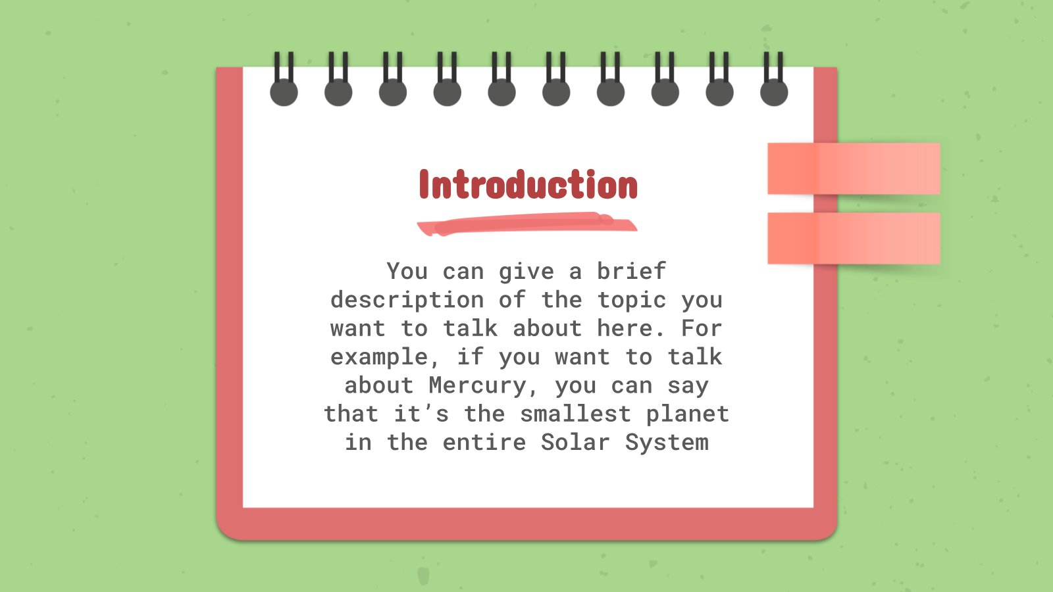

This slide is only for Premium users

Slide 10

—Someone Famous
Book Title. P52
“This is a quote. Words full of wisdom that someone important said and can make the reader get inspired.”

Slide 11
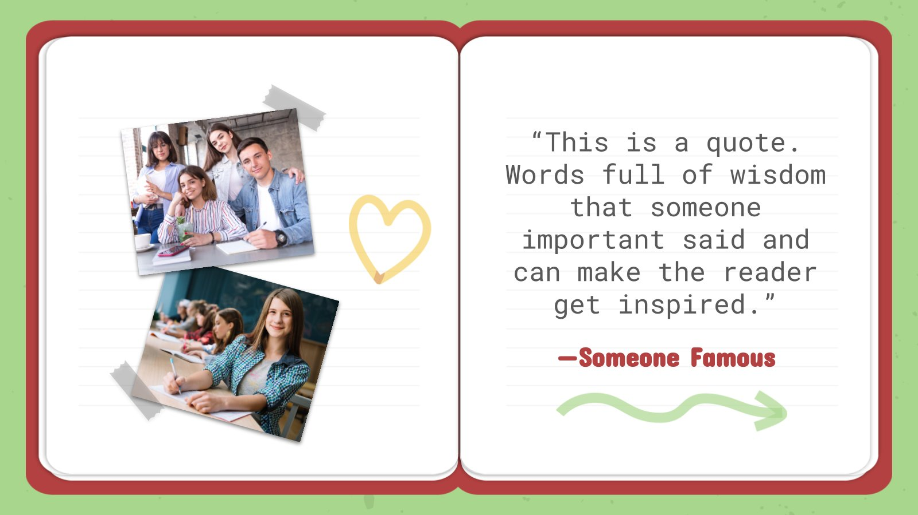
This slide is only for Premium users

Slide 12

What is this topic about?
You can explain here what is the topic about
You can explain here what is the topic about
You can explain here what is the topic about
You can explain here what is the topic about
You can explain here what is the topic about
You can replace this picture if you wish

Slide 13
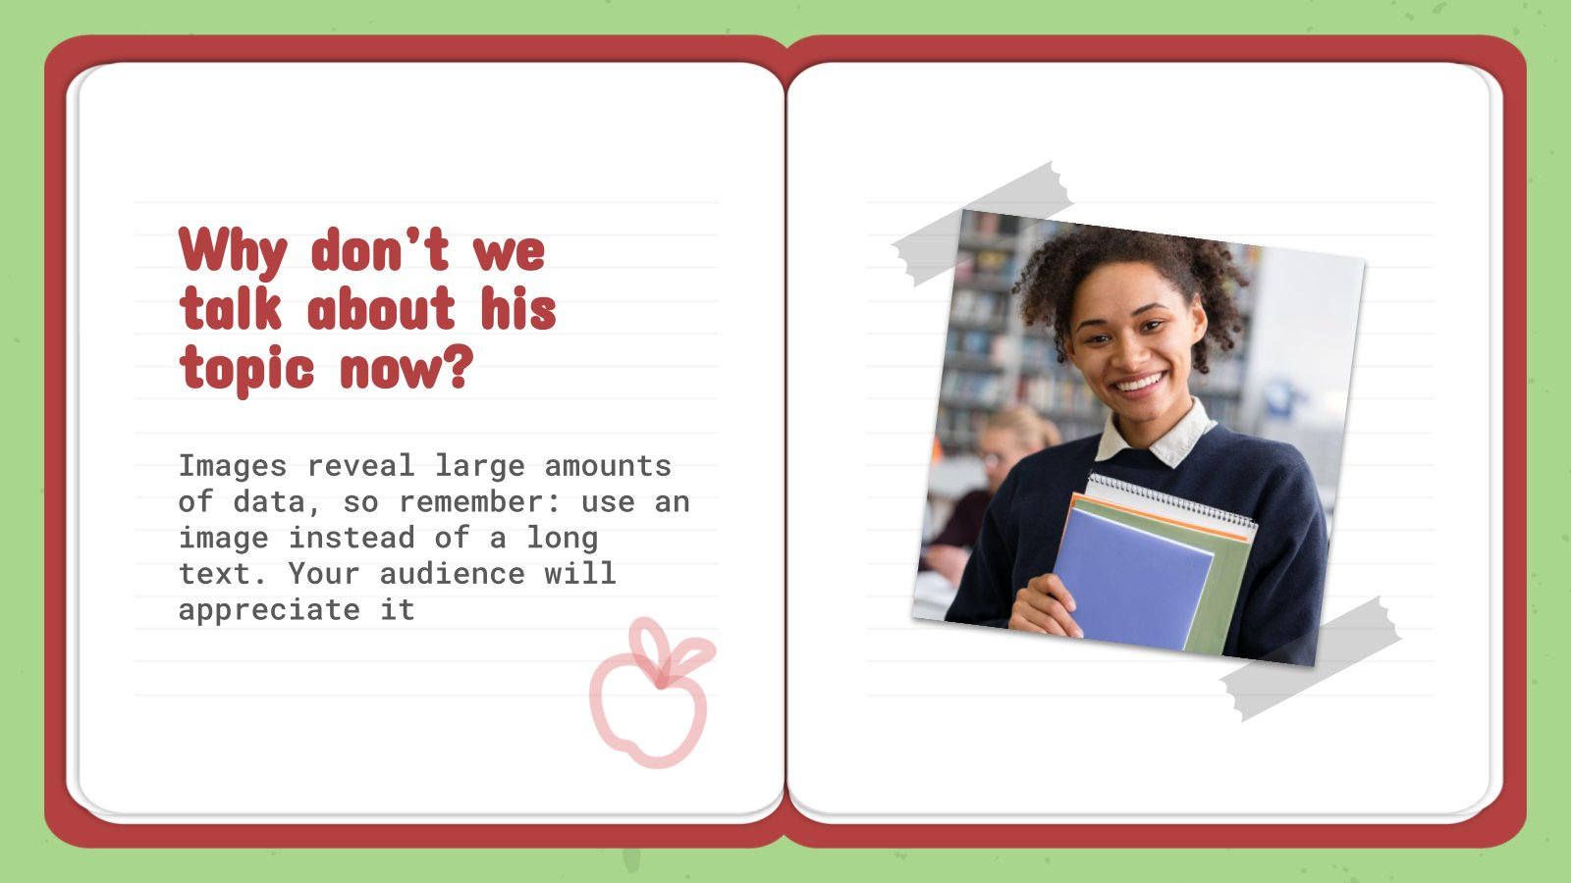
This slide is only for Premium users

Slide 14
Definition of concepts
Exam content
Mercury
Mars
Saturn
Venus
Mercury is the smallest planet
Despite being red, Mars is a cold place
It’s composed of hydrogen and helium
Venus is the second planet from the Sun

Slide 15
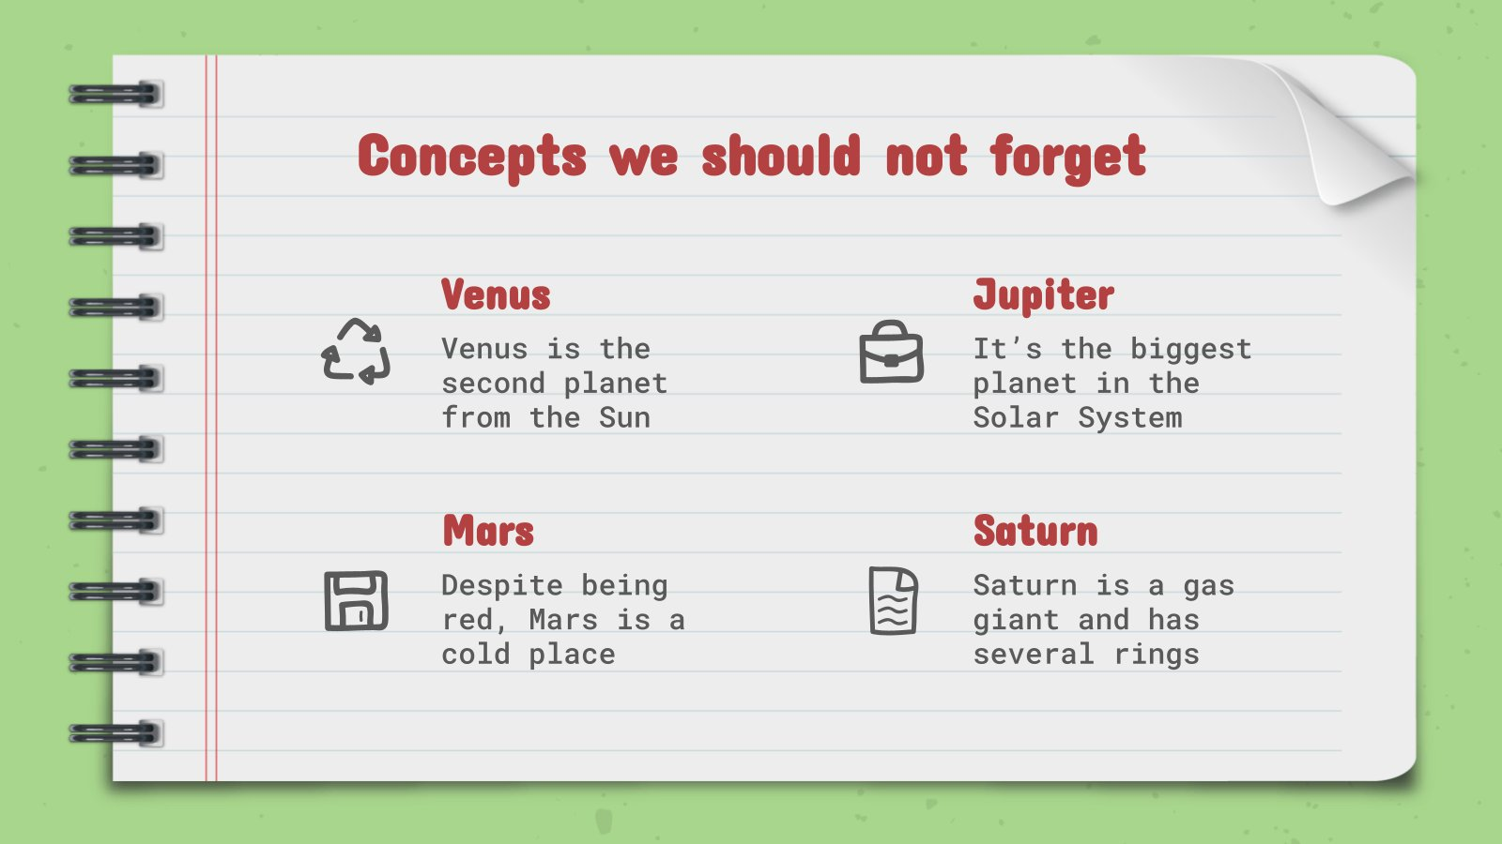
This slide is only for Premium users

Slide 16
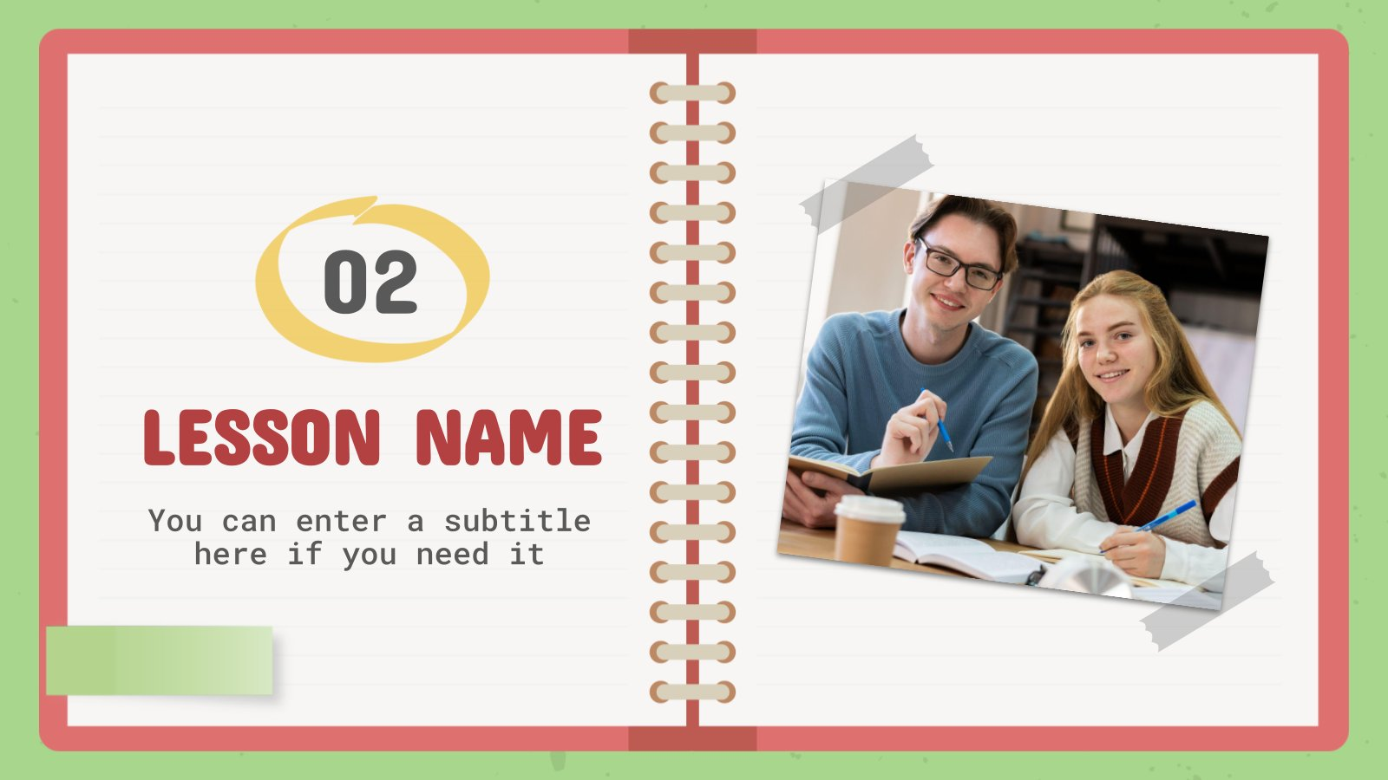
This slide is only for Premium users

Slide 17
Features of the topic
Mercury
Jupiter
Mars
It’s the closest planet to the Sun
Jupiter is the biggest planet
Venus is the second planet from the Sun
Mars is actually a cold place

Slide 18
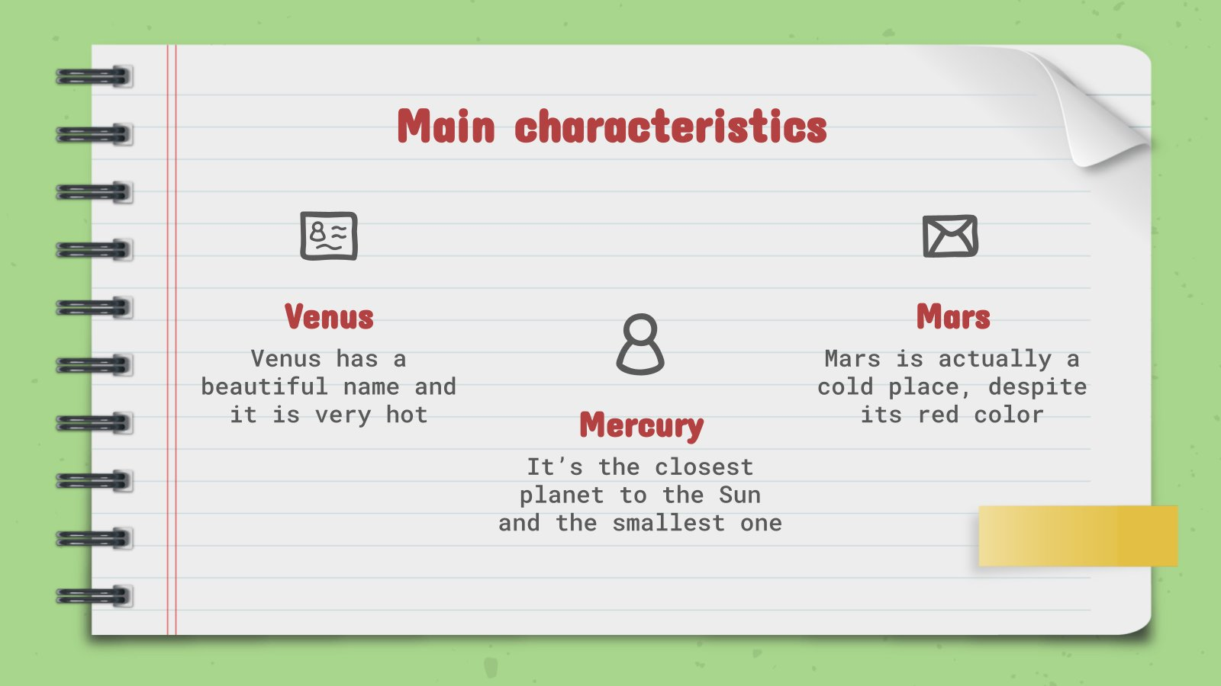
This slide is only for Premium users

Slide 19
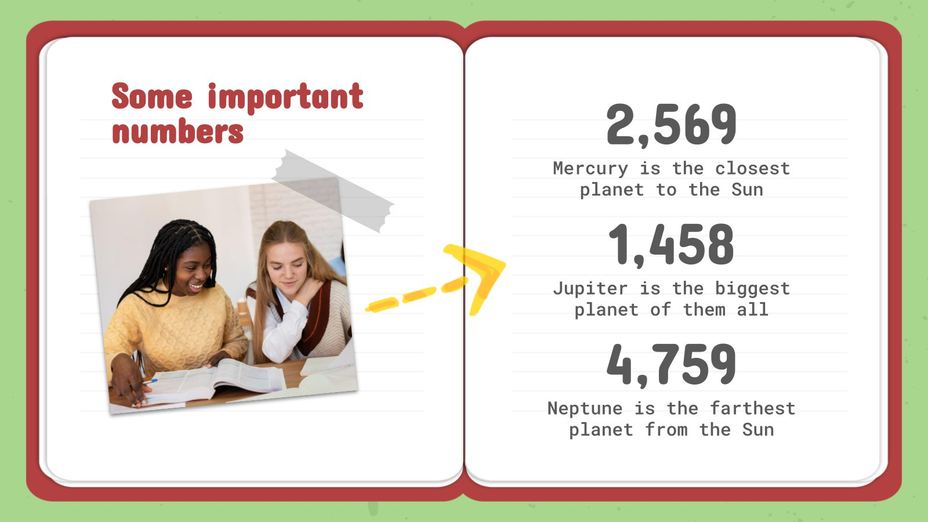
This slide is only for Premium users

Slide 20
10%
50%
40%
Despite being red, Mars is a cold place
Saturn is the only planet
with rings
Venus has a beautiful name, but it’s hot

Slide 21
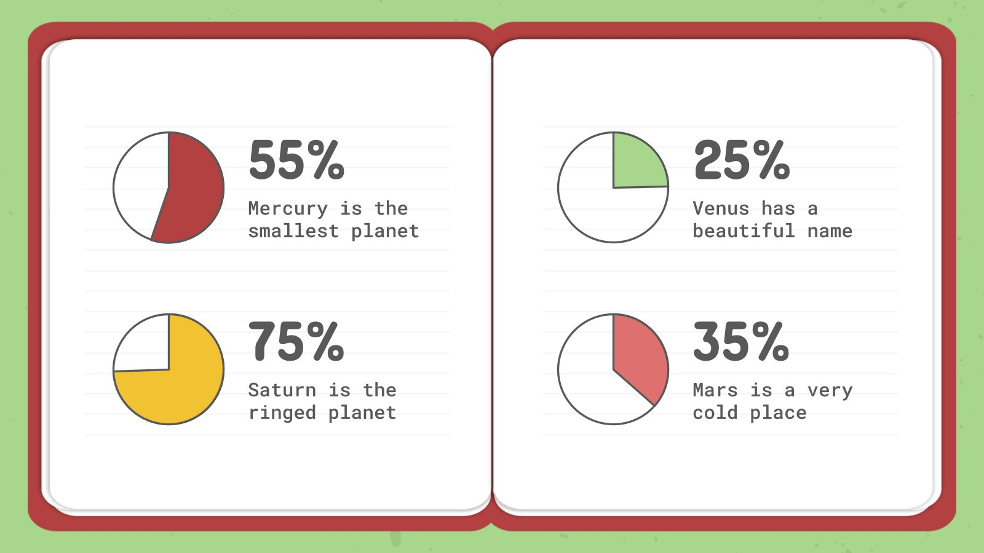
This slide is only for Premium users

Slide 22

Practical uses of this subject
Mercury
Jupiter
Mercury is the closest planet to the Sun
Venus is the second planet from the Sun
Jupiter is the biggest planet of them all

Slide 23

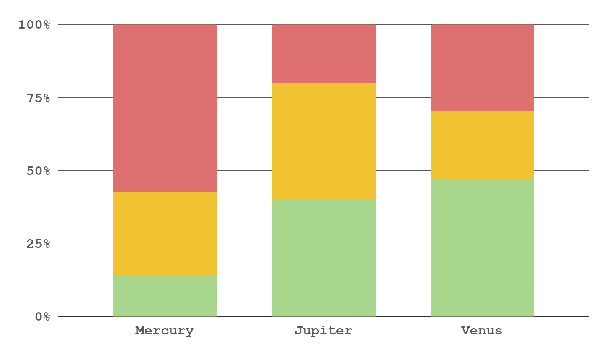
Did you know this?
35%
65%
To modify this graph, click on it, follow the link, change the data and replace this
Mercury is a small planet
Jupiter is a big planet
Factor 1
Factor 2
Factor 3

Slide 24

31,500
Big numbers catch your audience’s attention

Slide 25
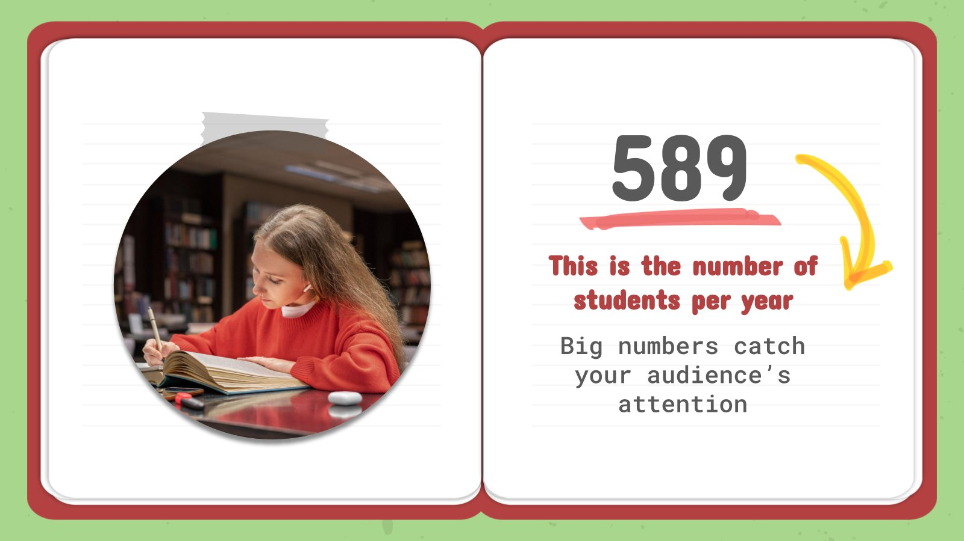
This slide is only for Premium users

Slide 26


Problem
Solution
Neptune is the fourth-largest planet in the Solar System
Jupiter is a gas giant and the biggest planet in the Solar System

Slide 27
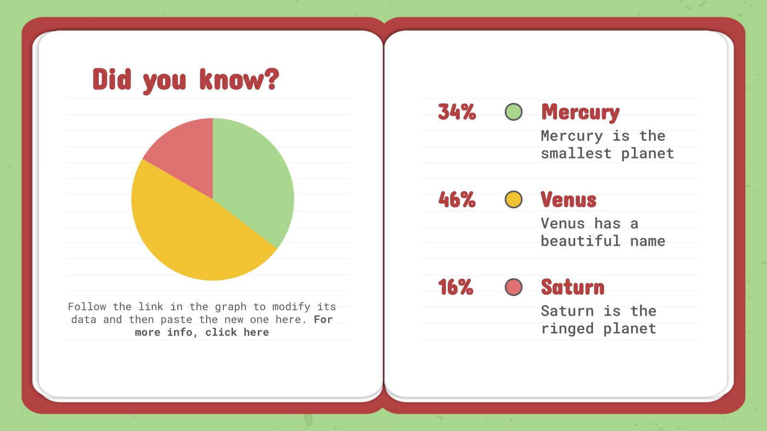
This slide is only for Premium users

Slide 28


Process
Mercury is the smallest planet
Saturn is the ringed planet
Step 1
Step 2
Step 3
Step 4
Venus has a beautiful name
Mars is a very cold place

Slide 29
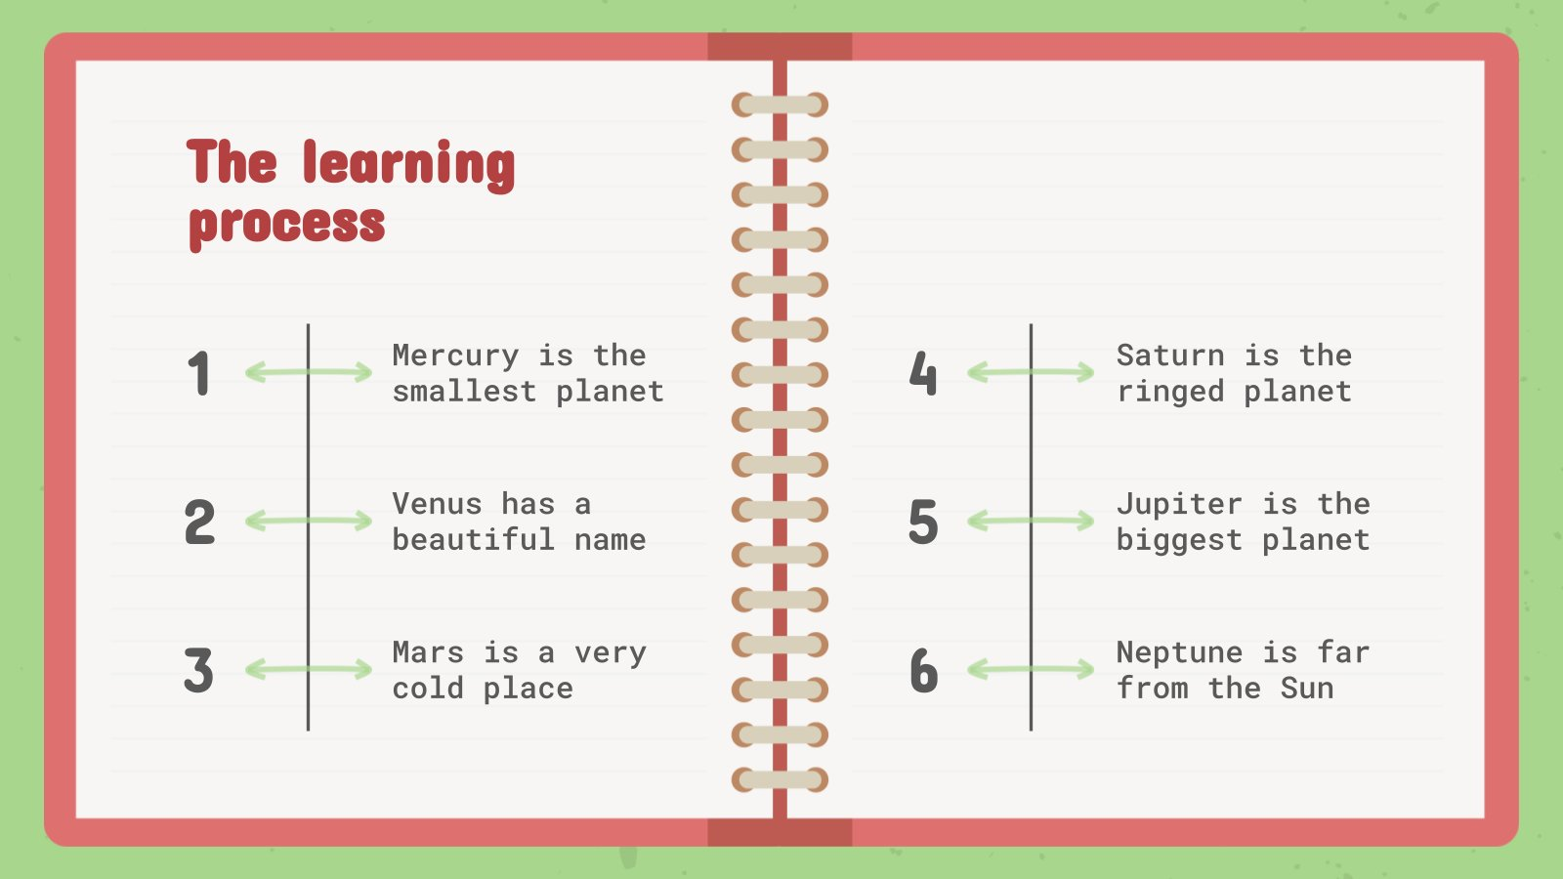
This slide is only for Premium users

Slide 30
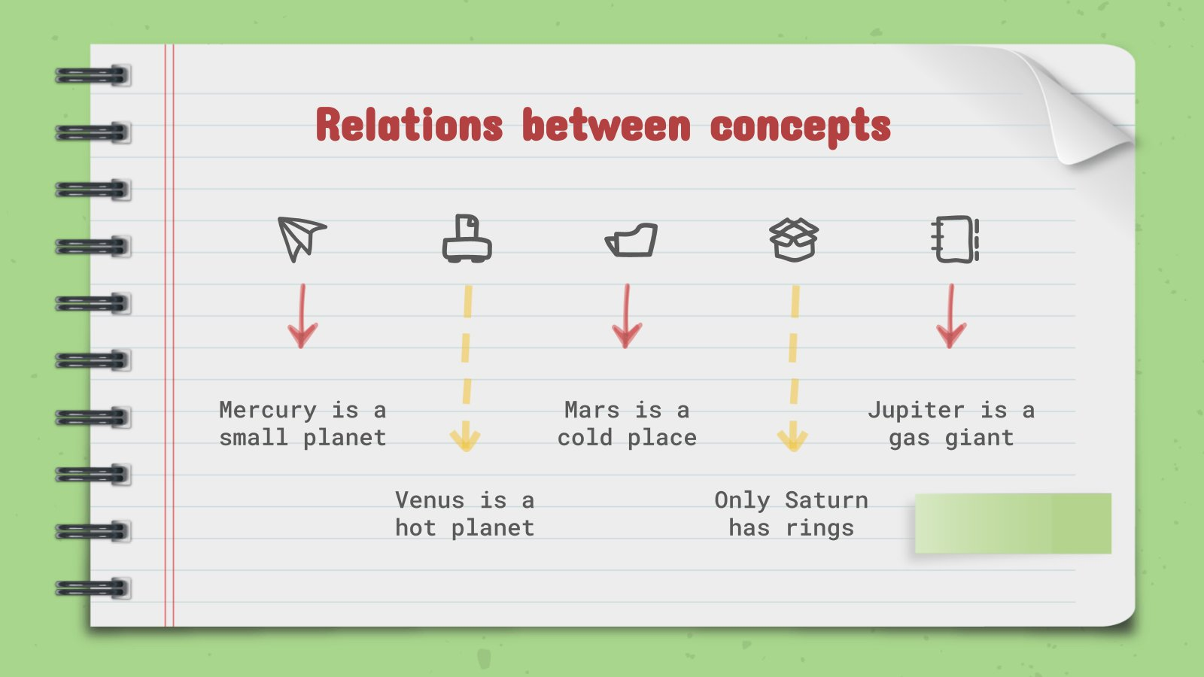
This slide is only for Premium users

Slide 31
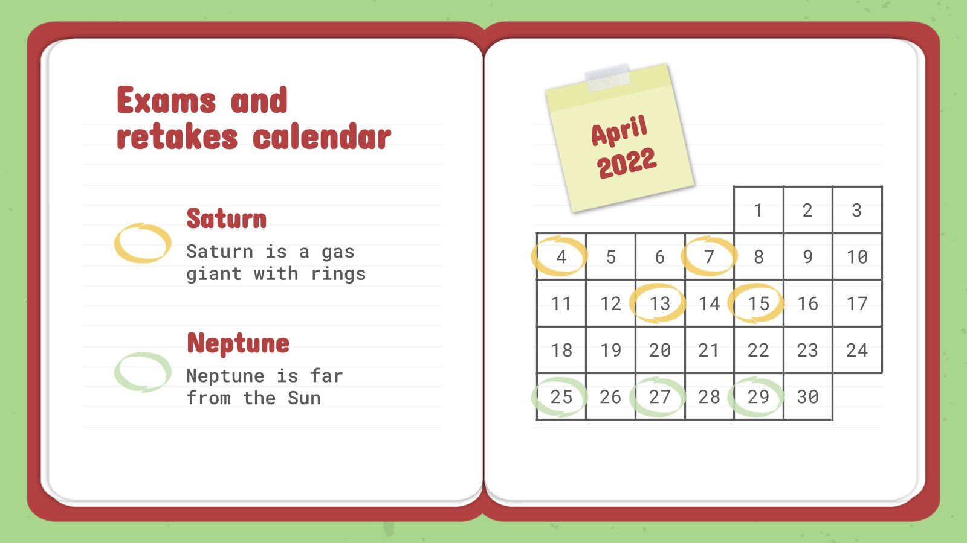
This slide is only for Premium users

Slide 32
Insert your multimedia content here
Despite being red, Mars is actually a cold place full of iron oxide dust

Slide 33
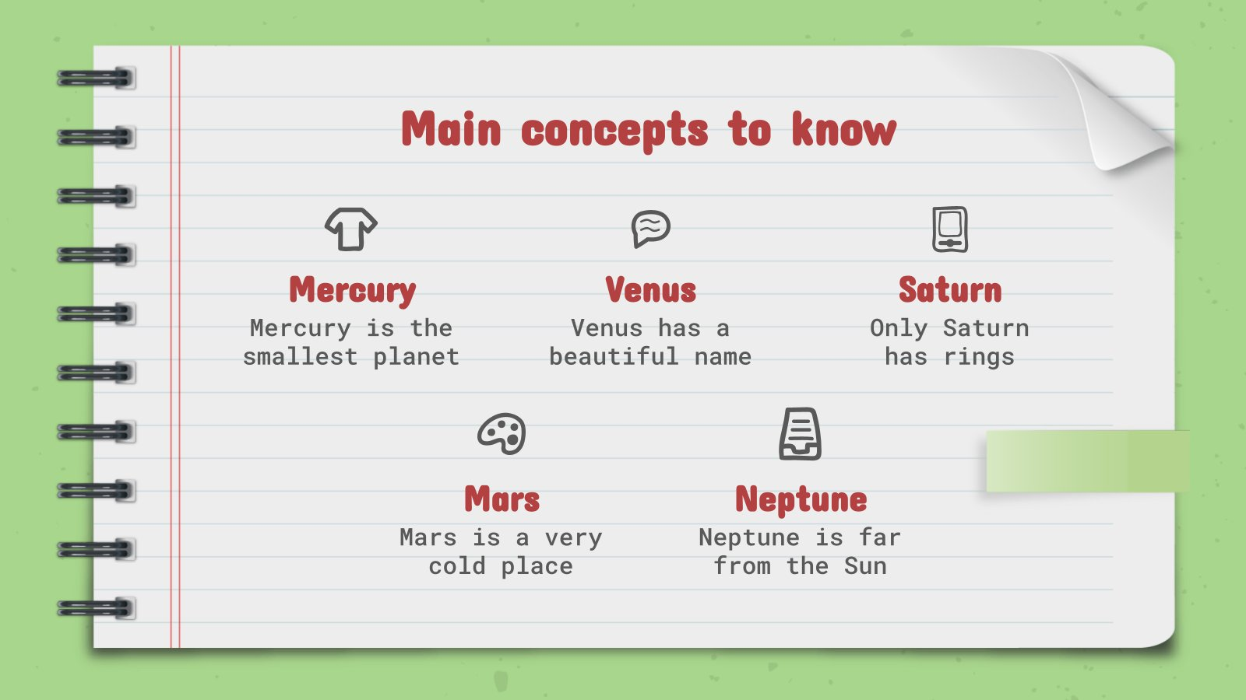
This slide is only for Premium users

Slide 34
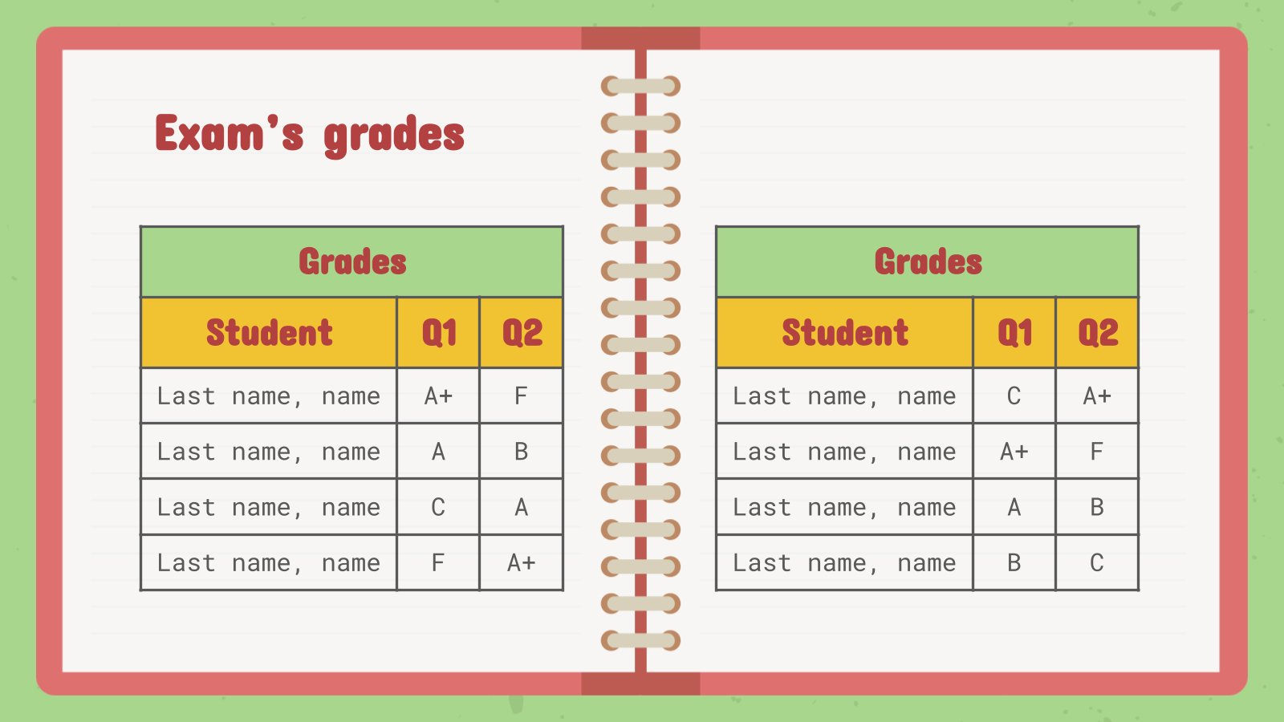
This slide is only for Premium users

Slide 35

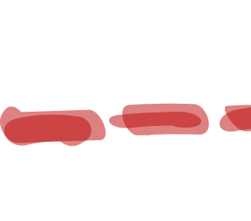

Overview diagram
30%
Mercury is a small planet
Venus is a hot planet
Mars is a cold place
Only Saturn has rings

Slide 36
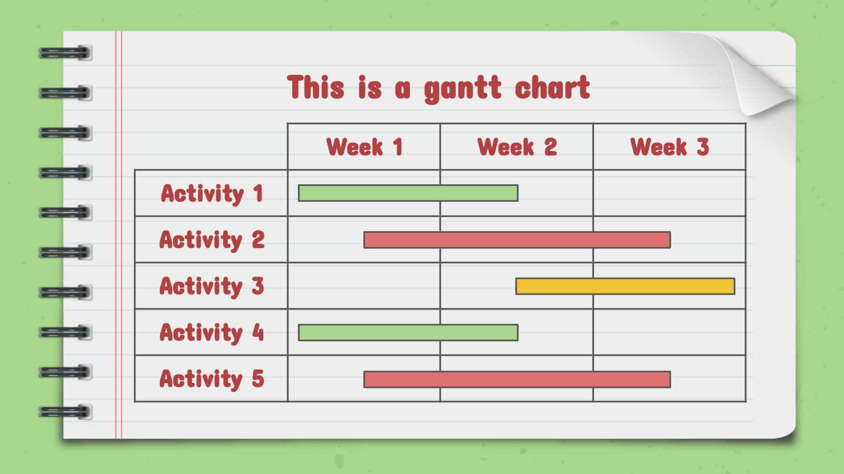
This slide is only for Premium users

Slide 37
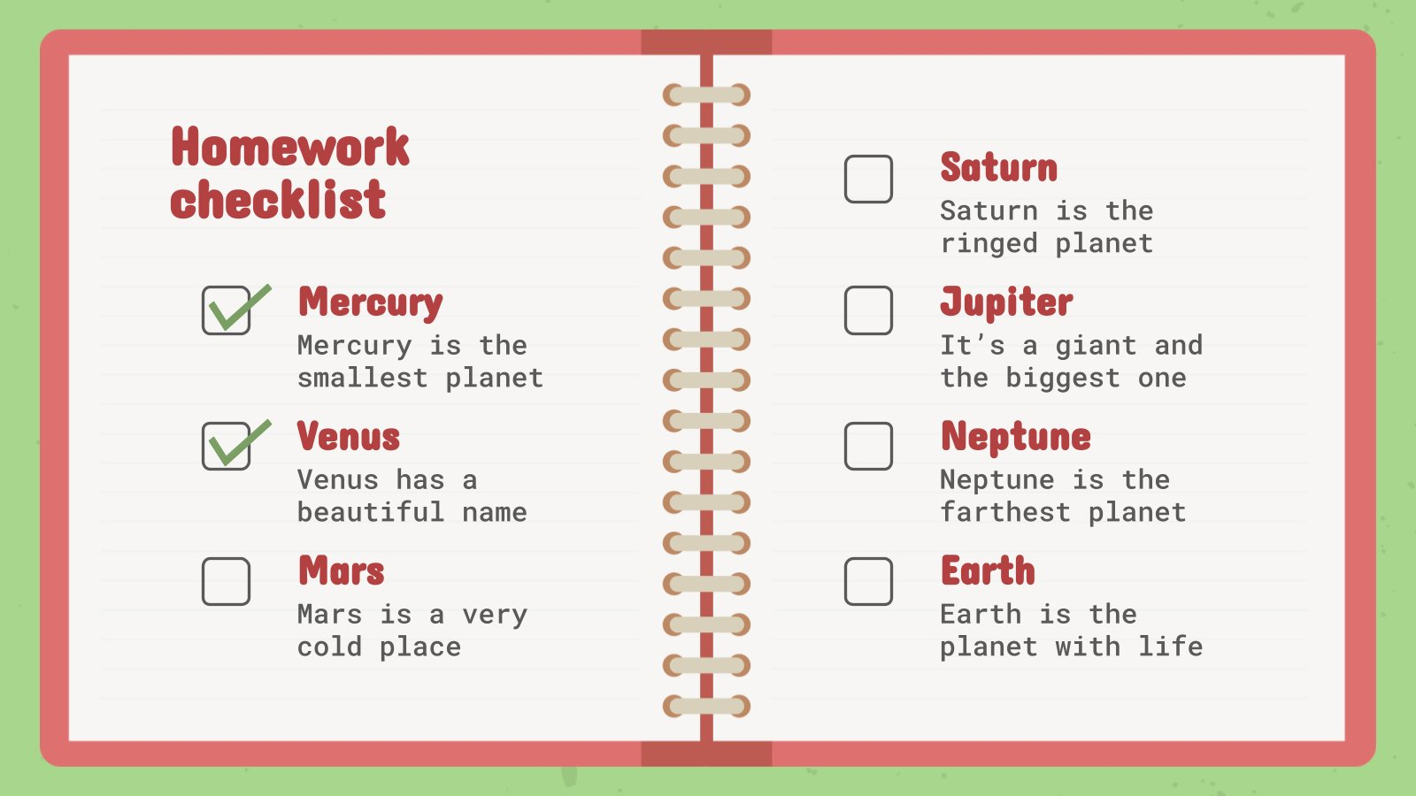
This slide is only for Premium users

Slide 38
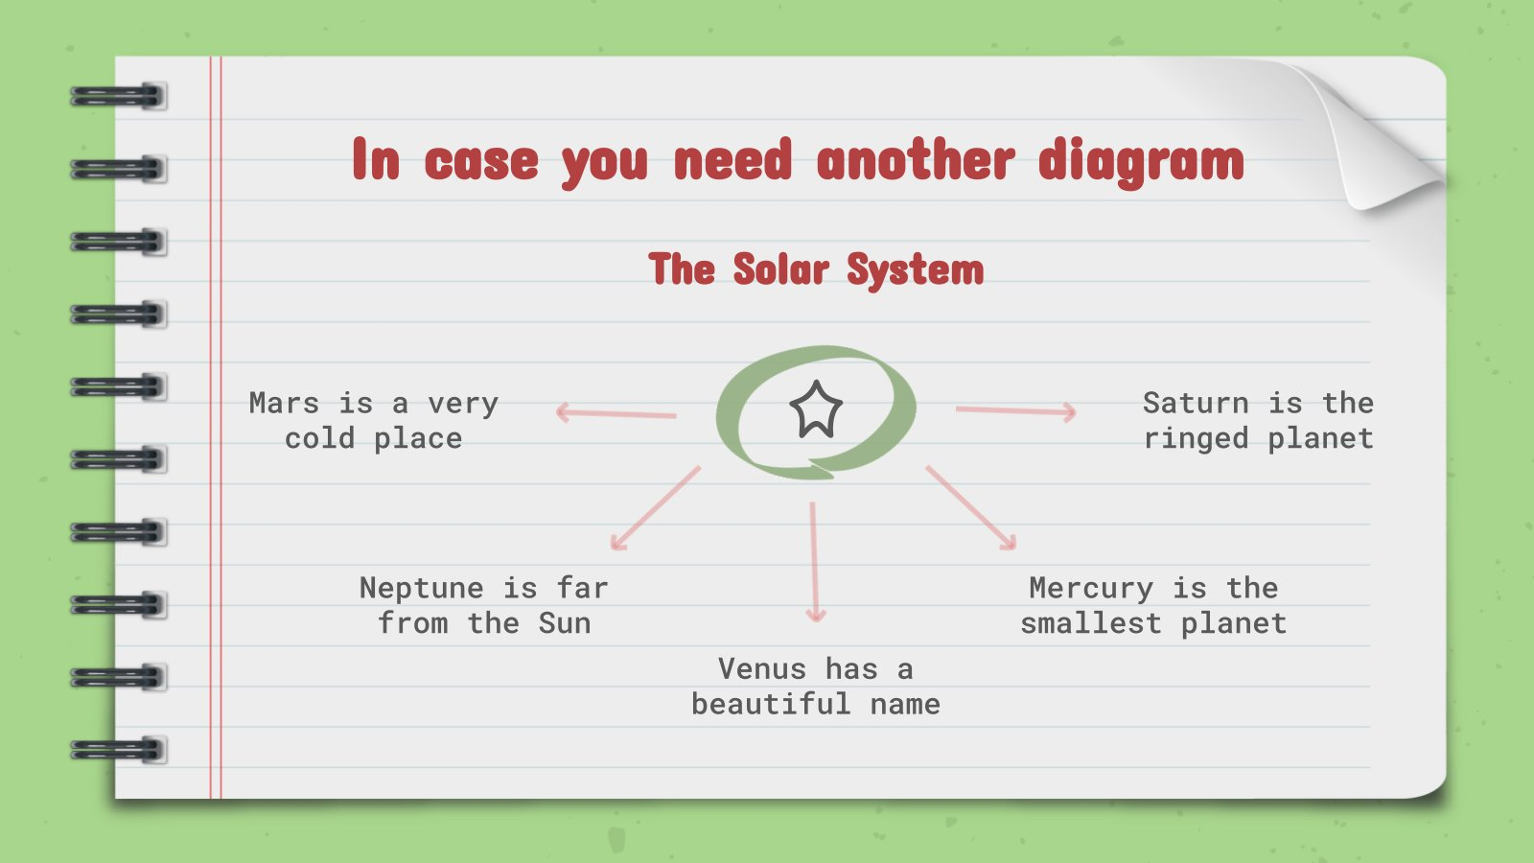
This slide is only for Premium users

Slide 39
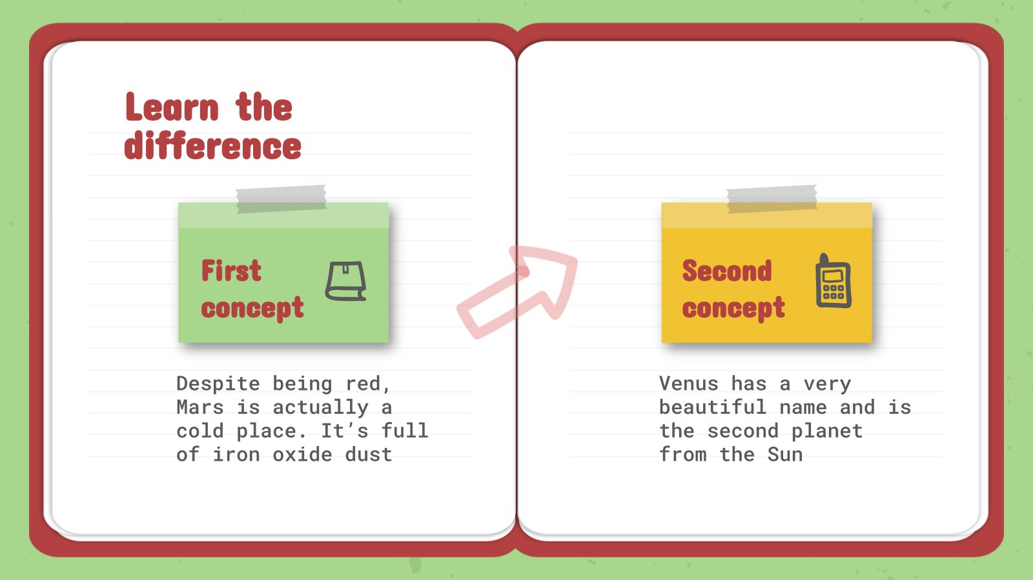
This slide is only for Premium users

Slide 40
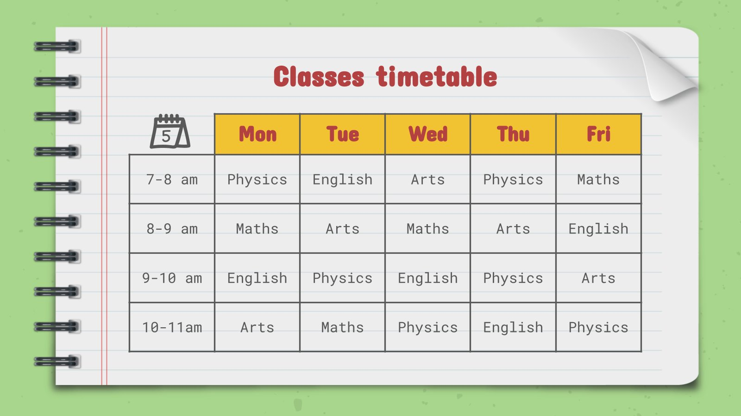
This slide is only for Premium users

Slide 41
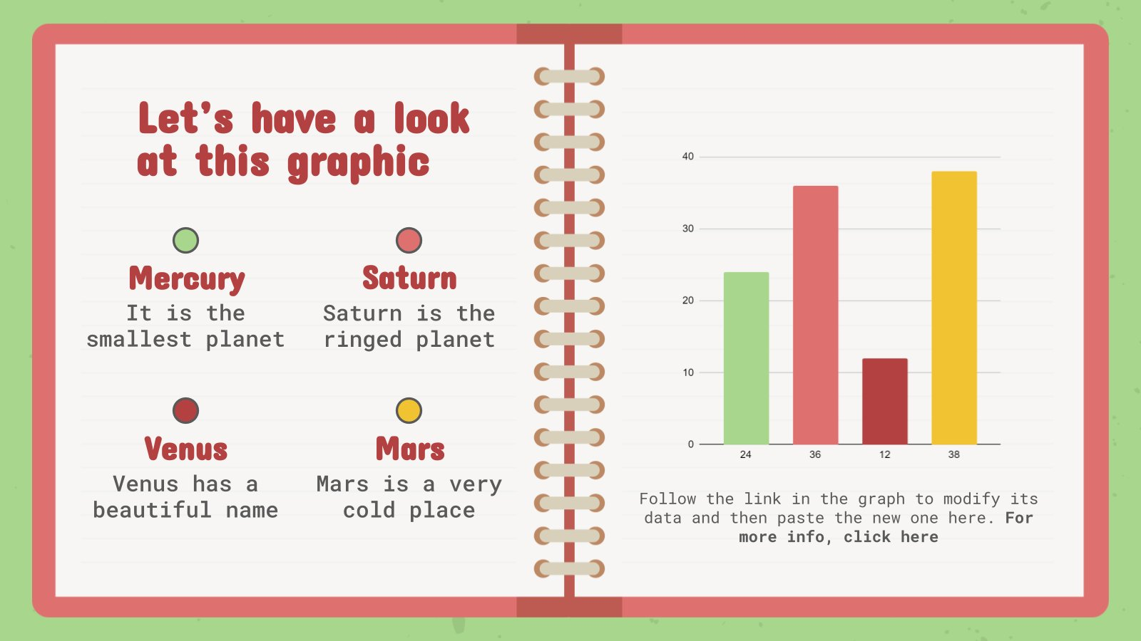
This slide is only for Premium users

Slide 42

This slide is only for Premium users

Slide 43
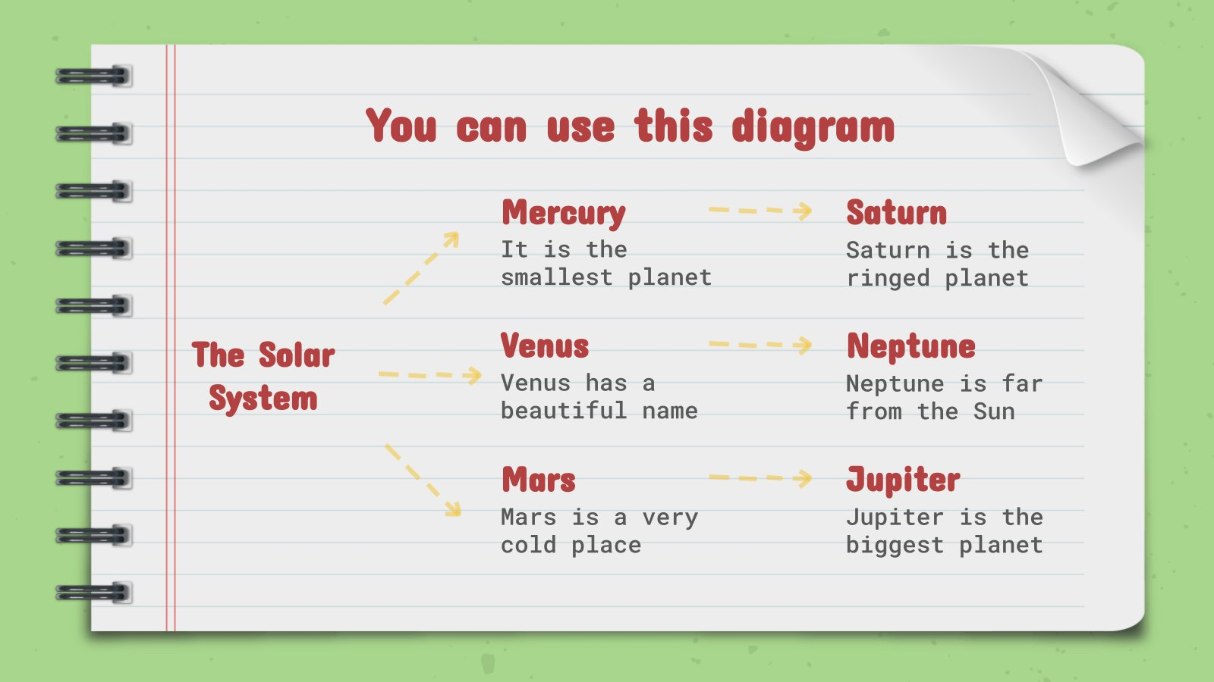
This slide is only for Premium users

Slide 44
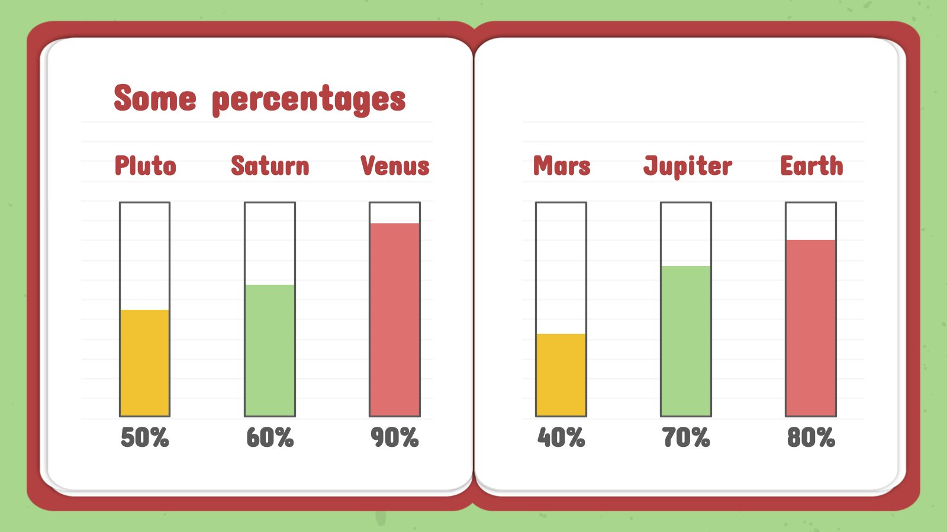
This slide is only for Premium users

Slide 45
Locations
Saturn is a gas giant
Mars is a cold place

Slide 46

A picture reinforces the concept

Slide 47
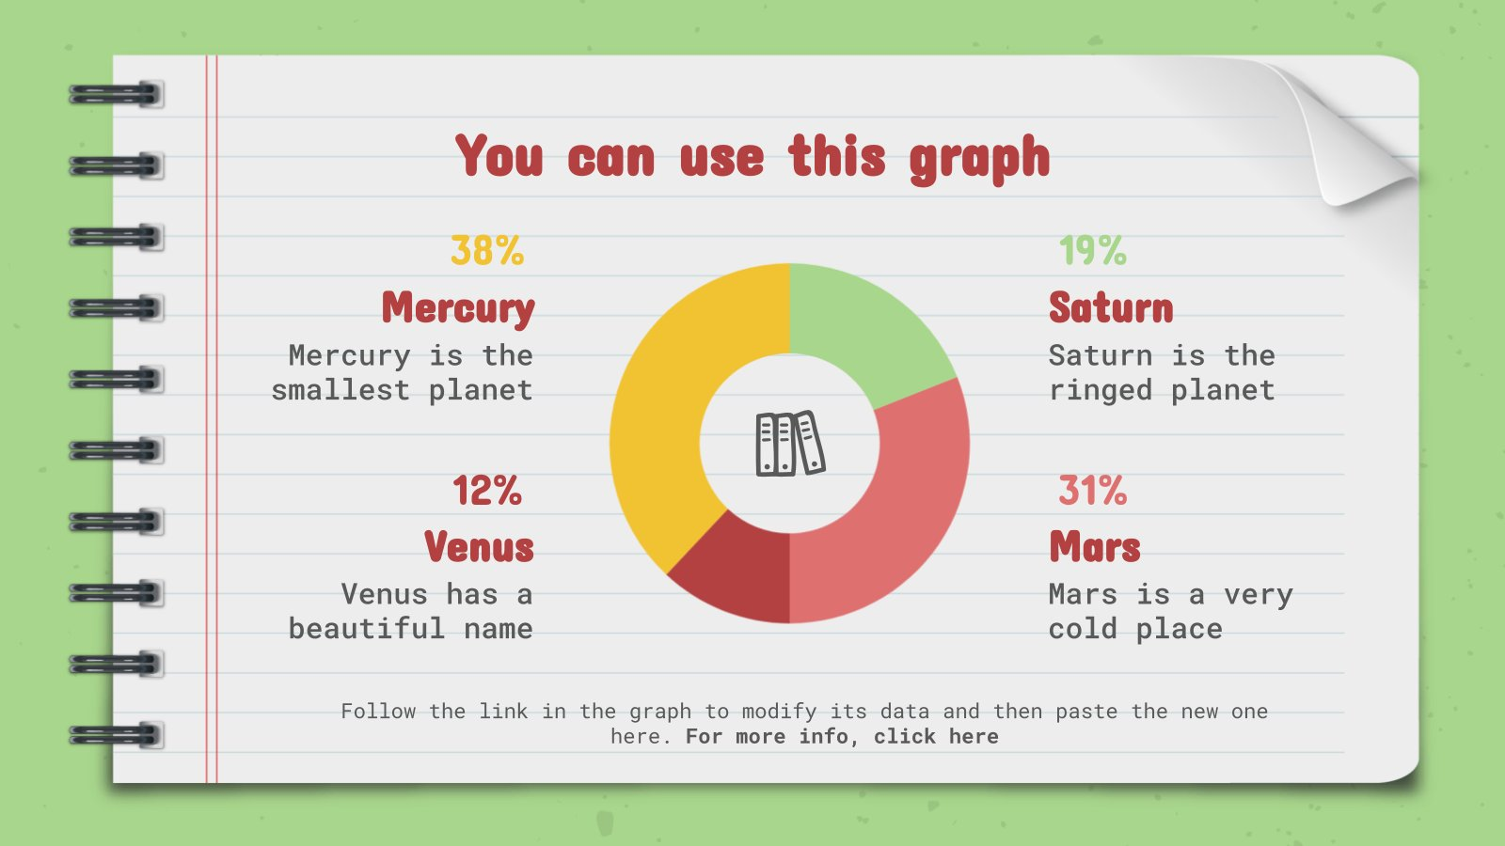
This slide is only for Premium users

Slide 48
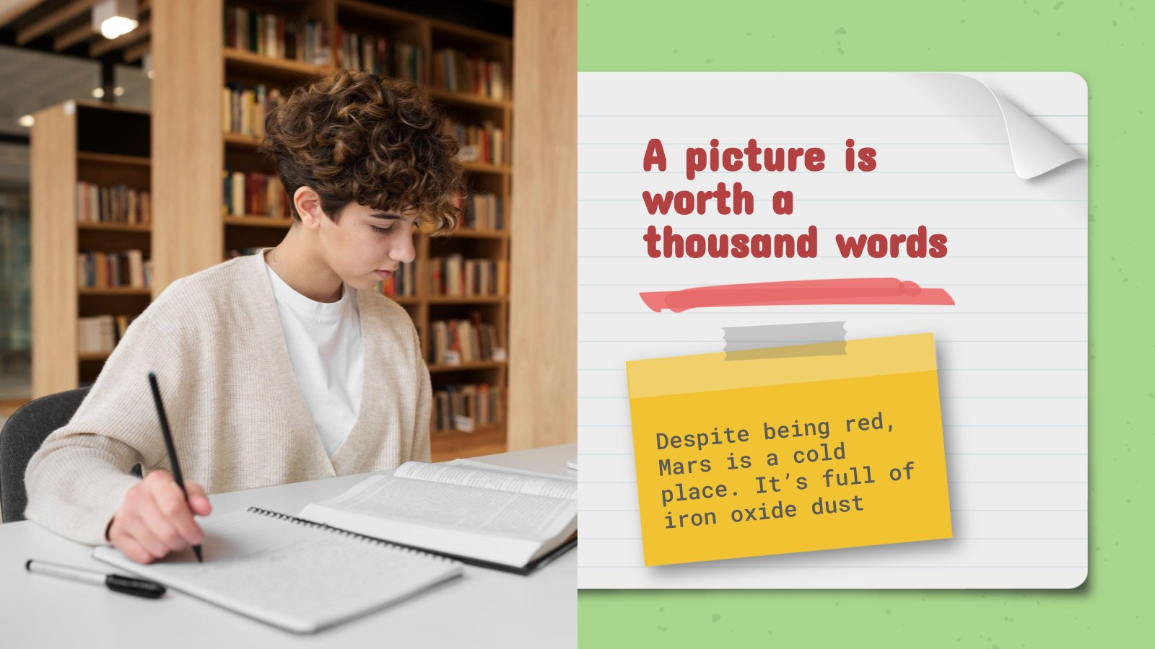
This slide is only for Premium users

Slide 49
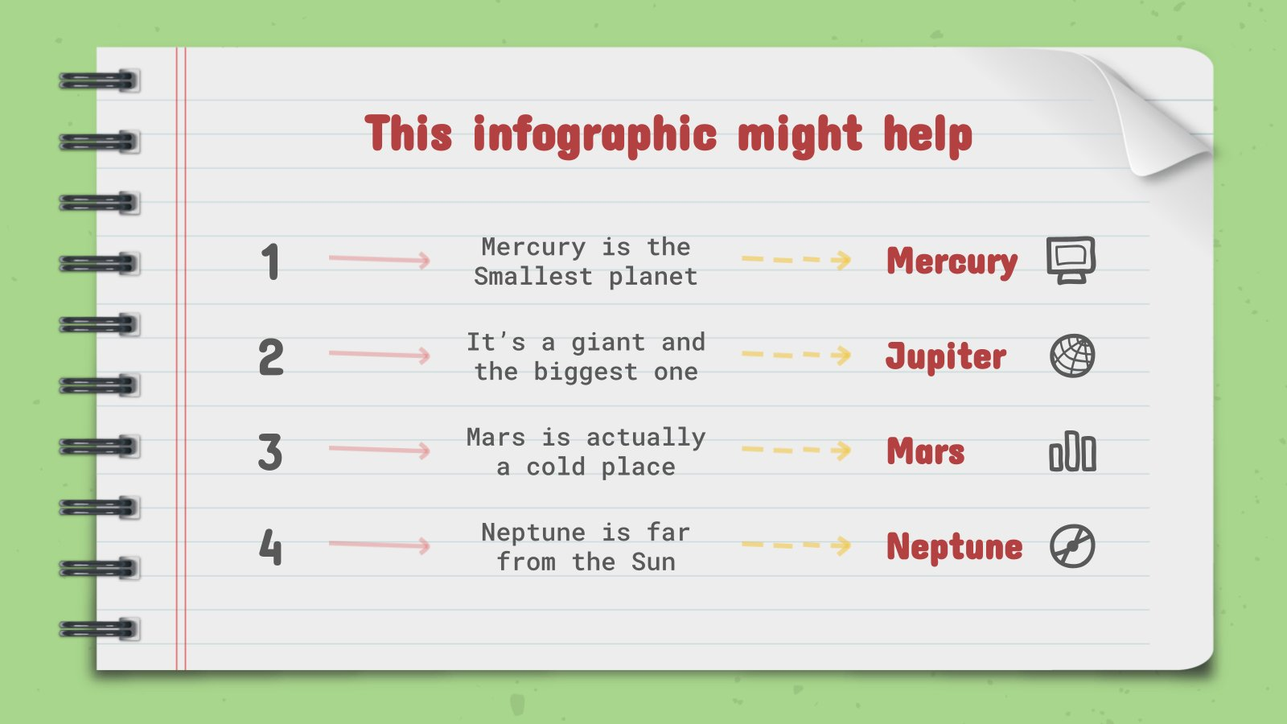
This slide is only for Premium users

Slide 50
Data review
Study 1 | Study 2 | Study 3
0.3 | 1.2 | 4.5
1.4 | 0.6 | 7.8
Study 1 | Study 2 | Study 3
2.5 | 6.9 | 1.6
3.5 | 7.7 | 1.8

Slide 51
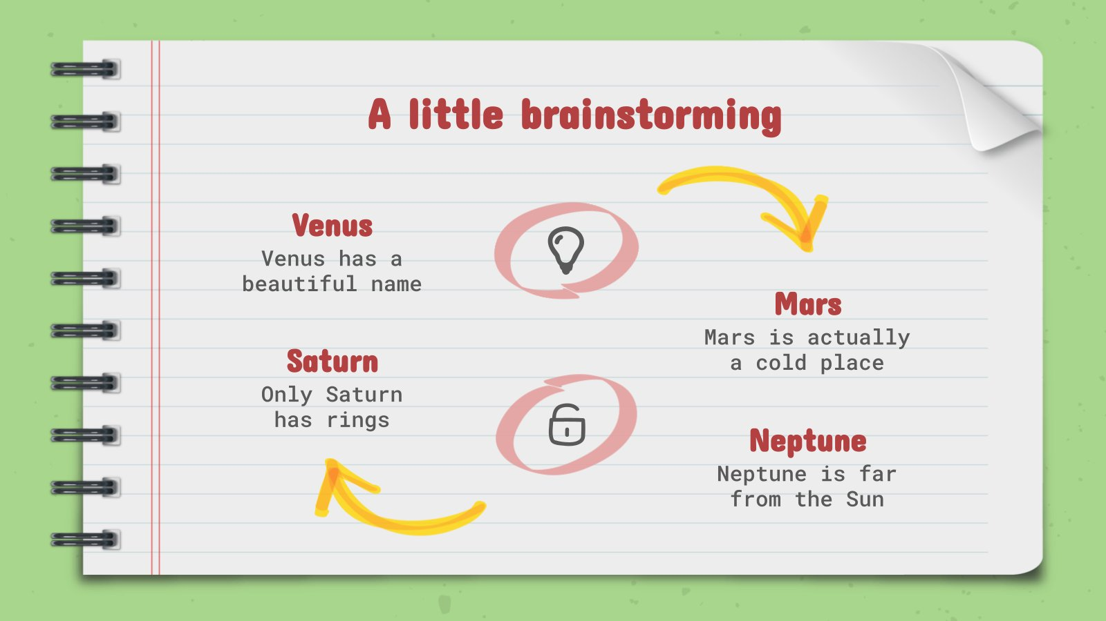
This slide is only for Premium users

Slide 52
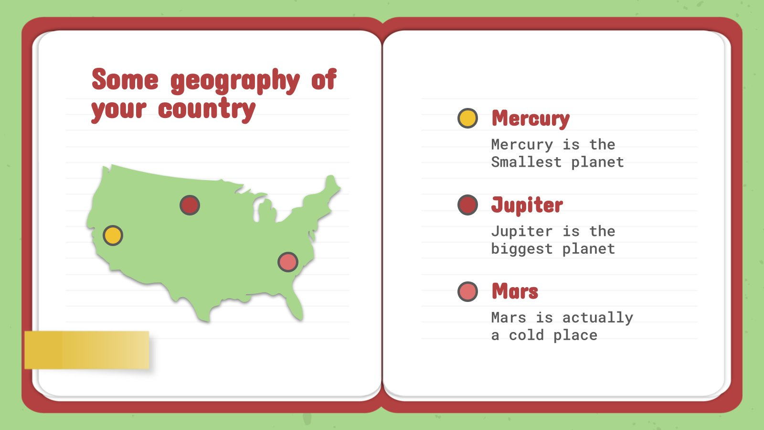
This slide is only for Premium users

Slide 53
Review of concepts
Mercury
Venus
Mars
Jupiter
Saturn
Neptune
Mercury is the
Smallest planet
Venus has a
beautiful name
Mars is actually a cold place
Jupiter is the biggest planet
Saturn is the
ringed one
Neptune is very far from us

Slide 54
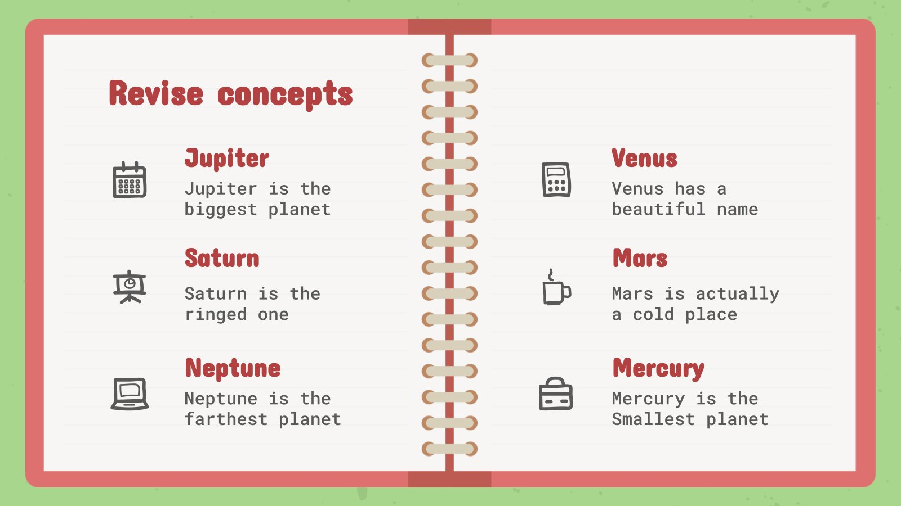
This slide is only for Premium users

Slide 55
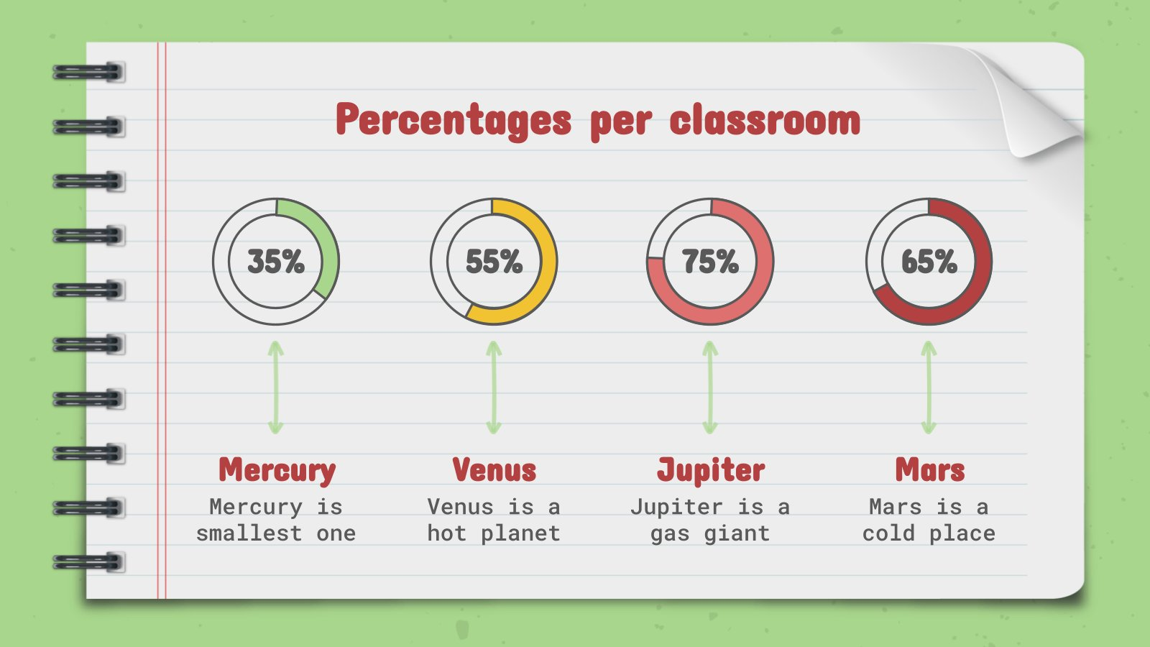
This slide is only for Premium users

Slide 56
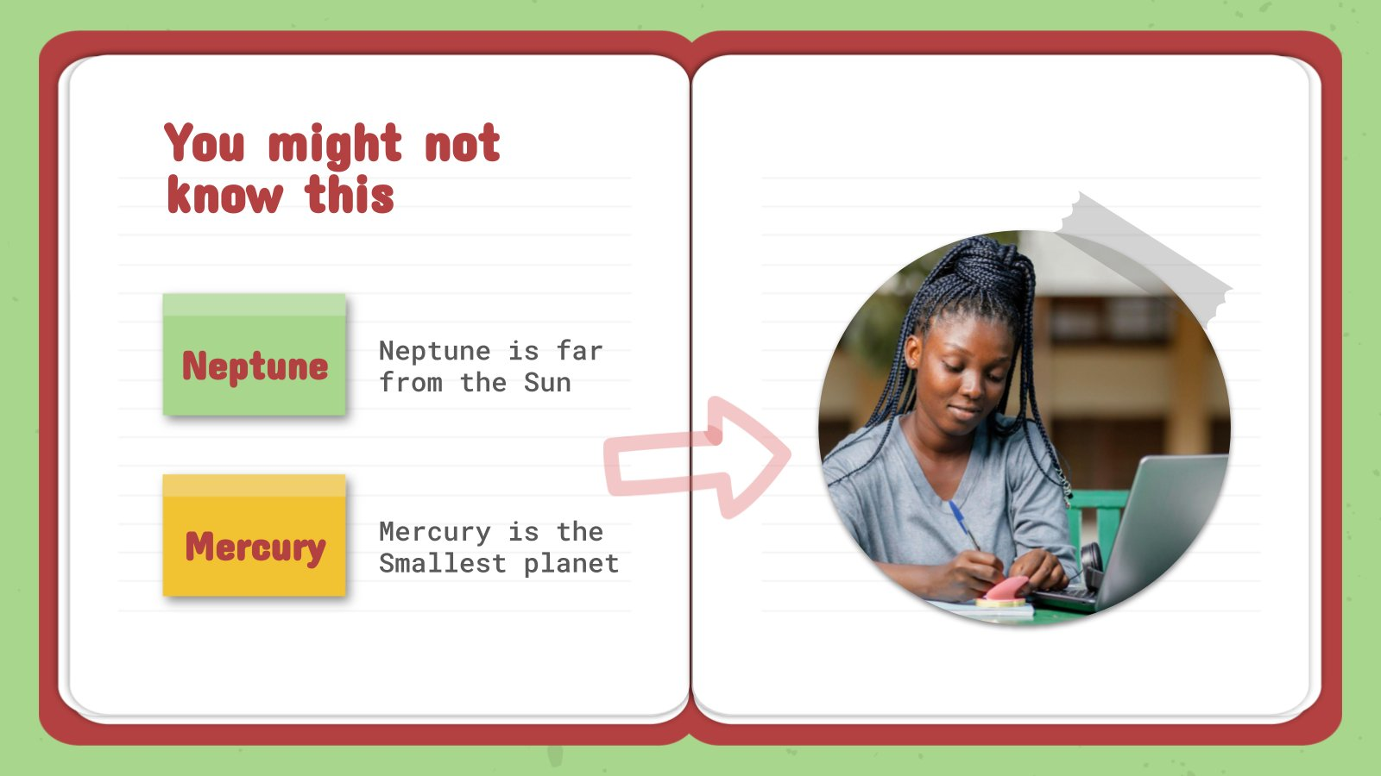
This slide is only for Premium users

Slide 57
Exercise
Venus has a beautiful name and is the second planet from the Sun
Despite being red, Mars is actually a cold place

Slide 58
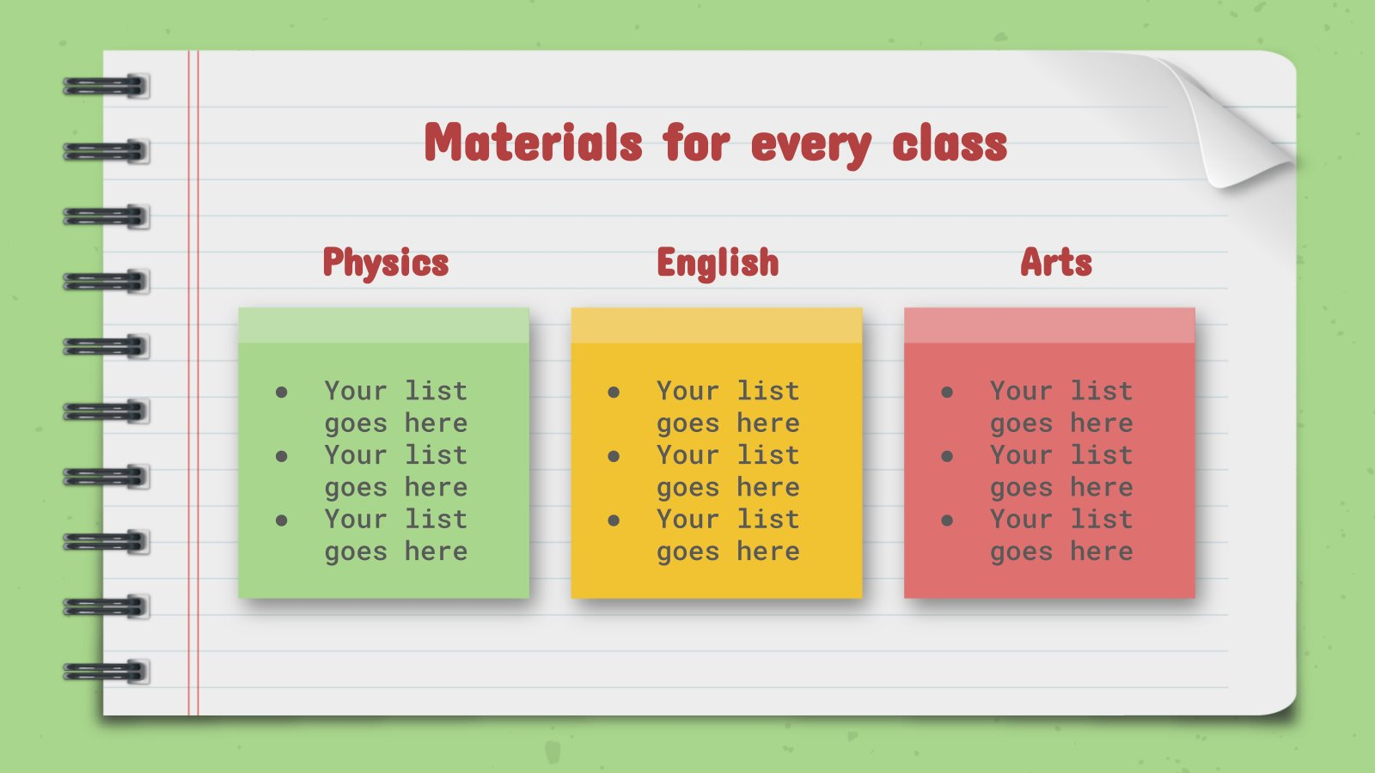
This slide is only for Premium users

Slide 59
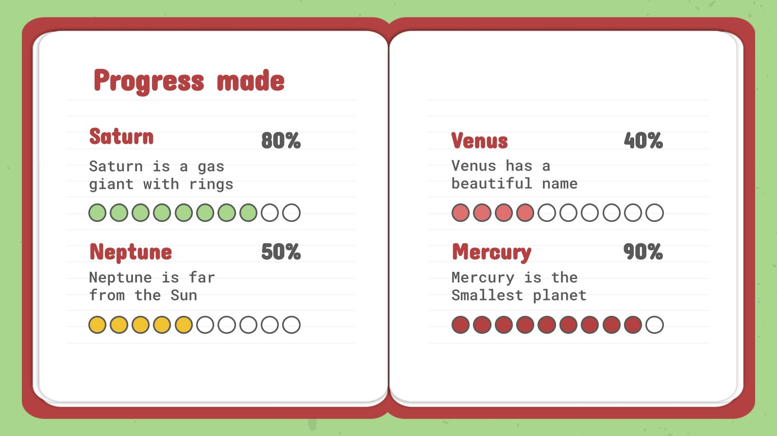
This slide is only for Premium users

Slide 60
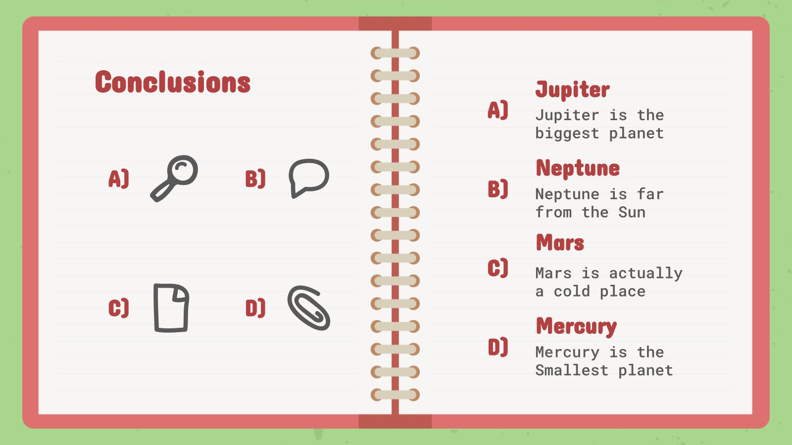
This slide is only for Premium users

Slide 61
Assignment
Which planet has a beautiful name and is the second one from the Sun

Slide 62
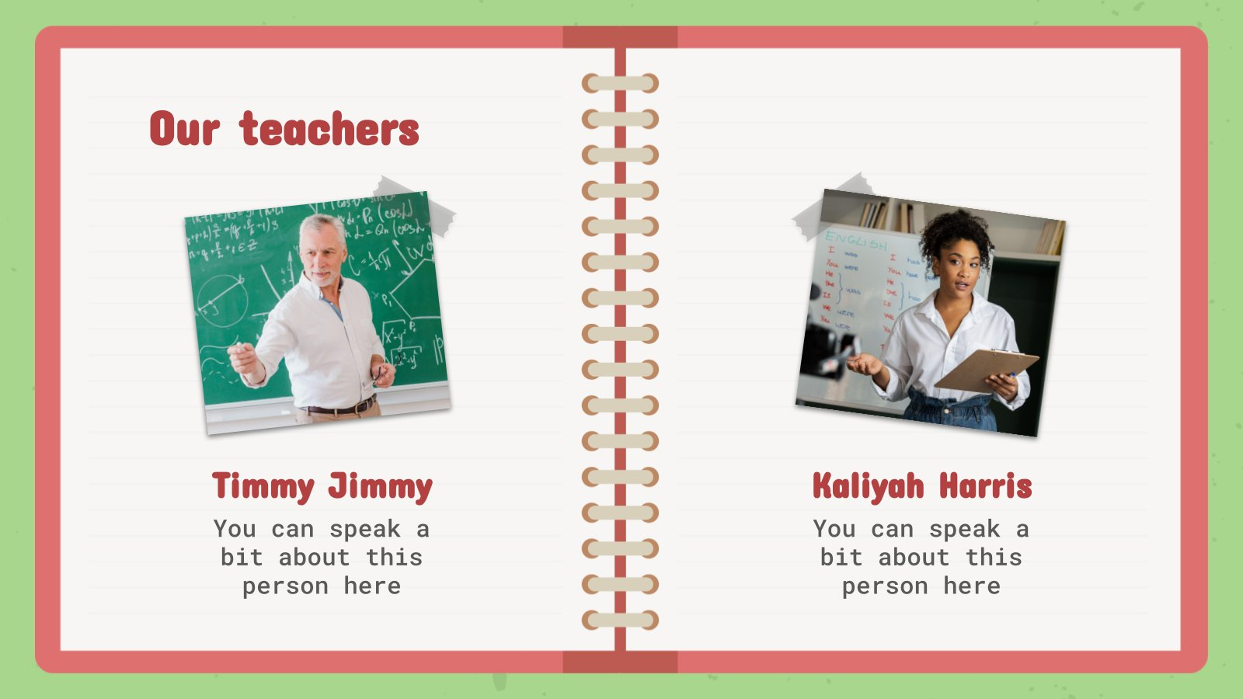
This slide is only for Premium users

Slide 63
Thanks!
Do you have any questions? youremail@freepik.com +91 620 421 838 yourcompany.com
Please keep this slide for attribution.

Slide 64
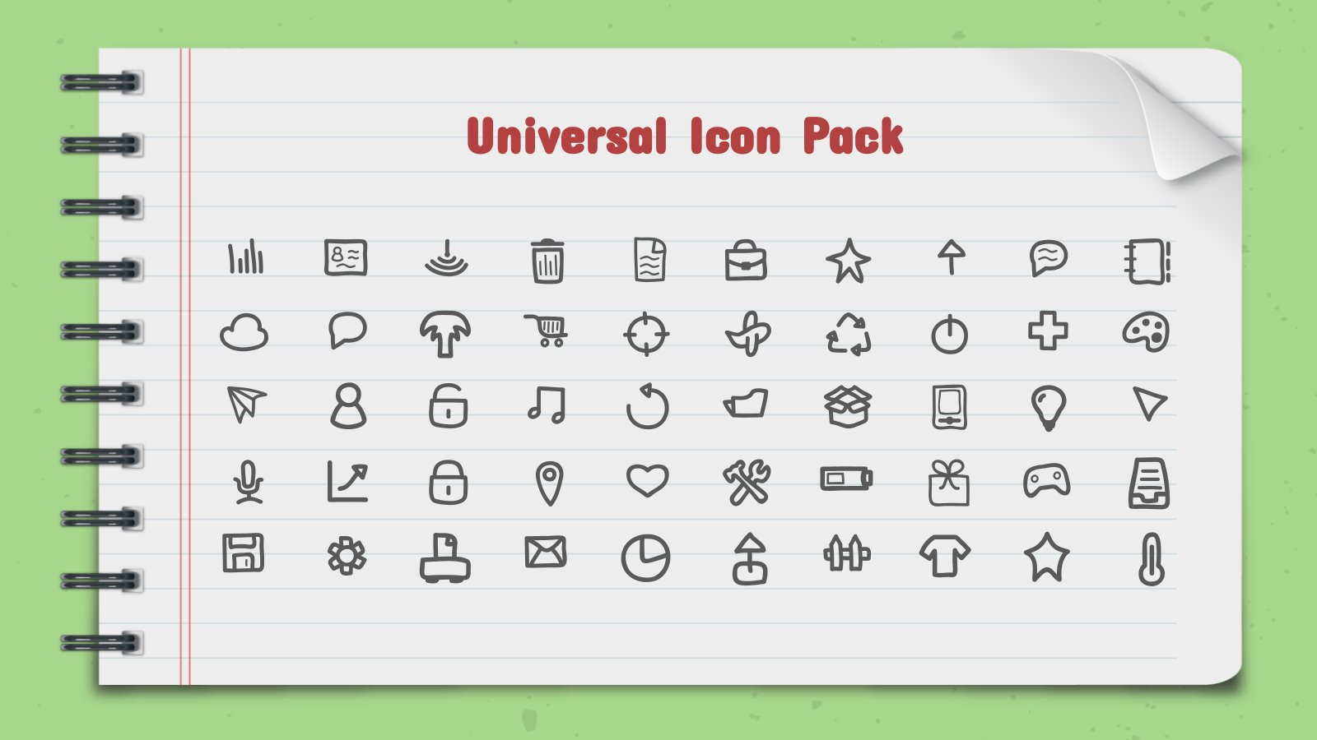
This slide is only for Premium users

Slide 65
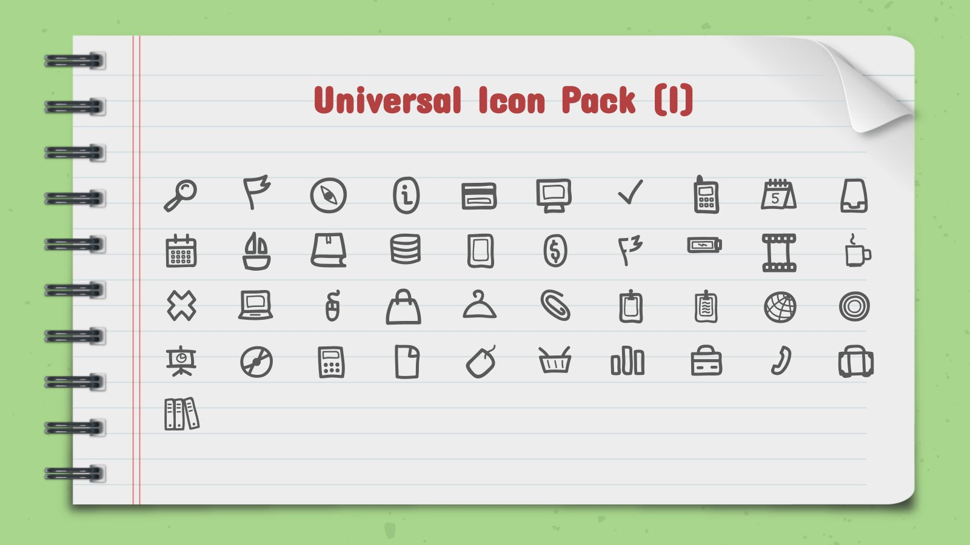
This slide is only for Premium users

Slide 66
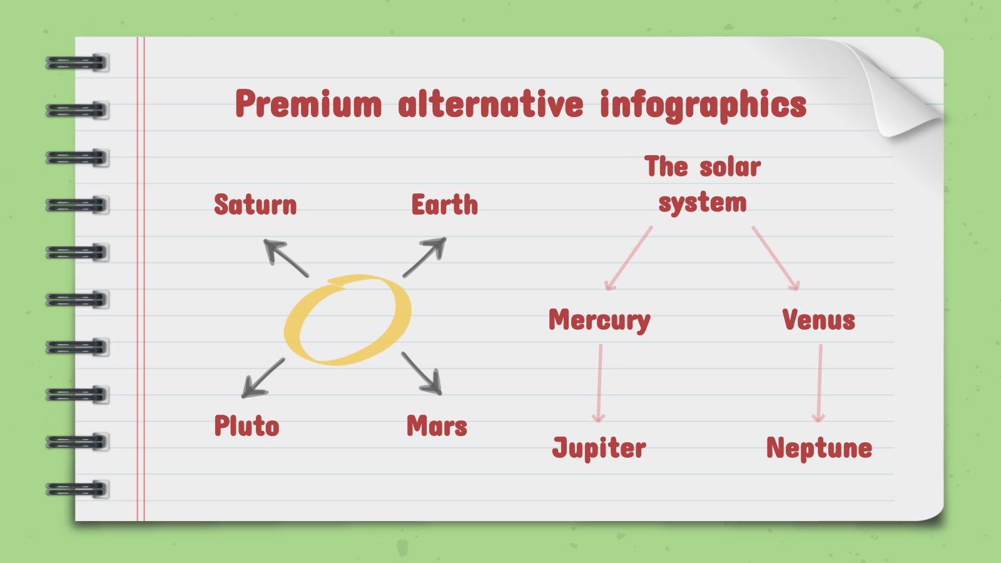
This slide is only for Premium users

Slide 67



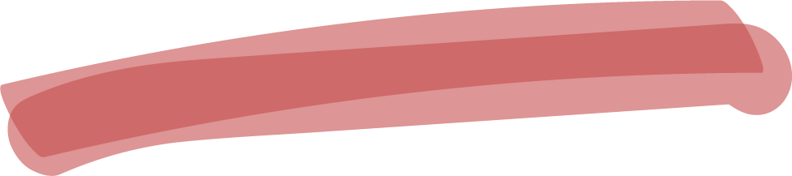

Alternative resources

Slide 68
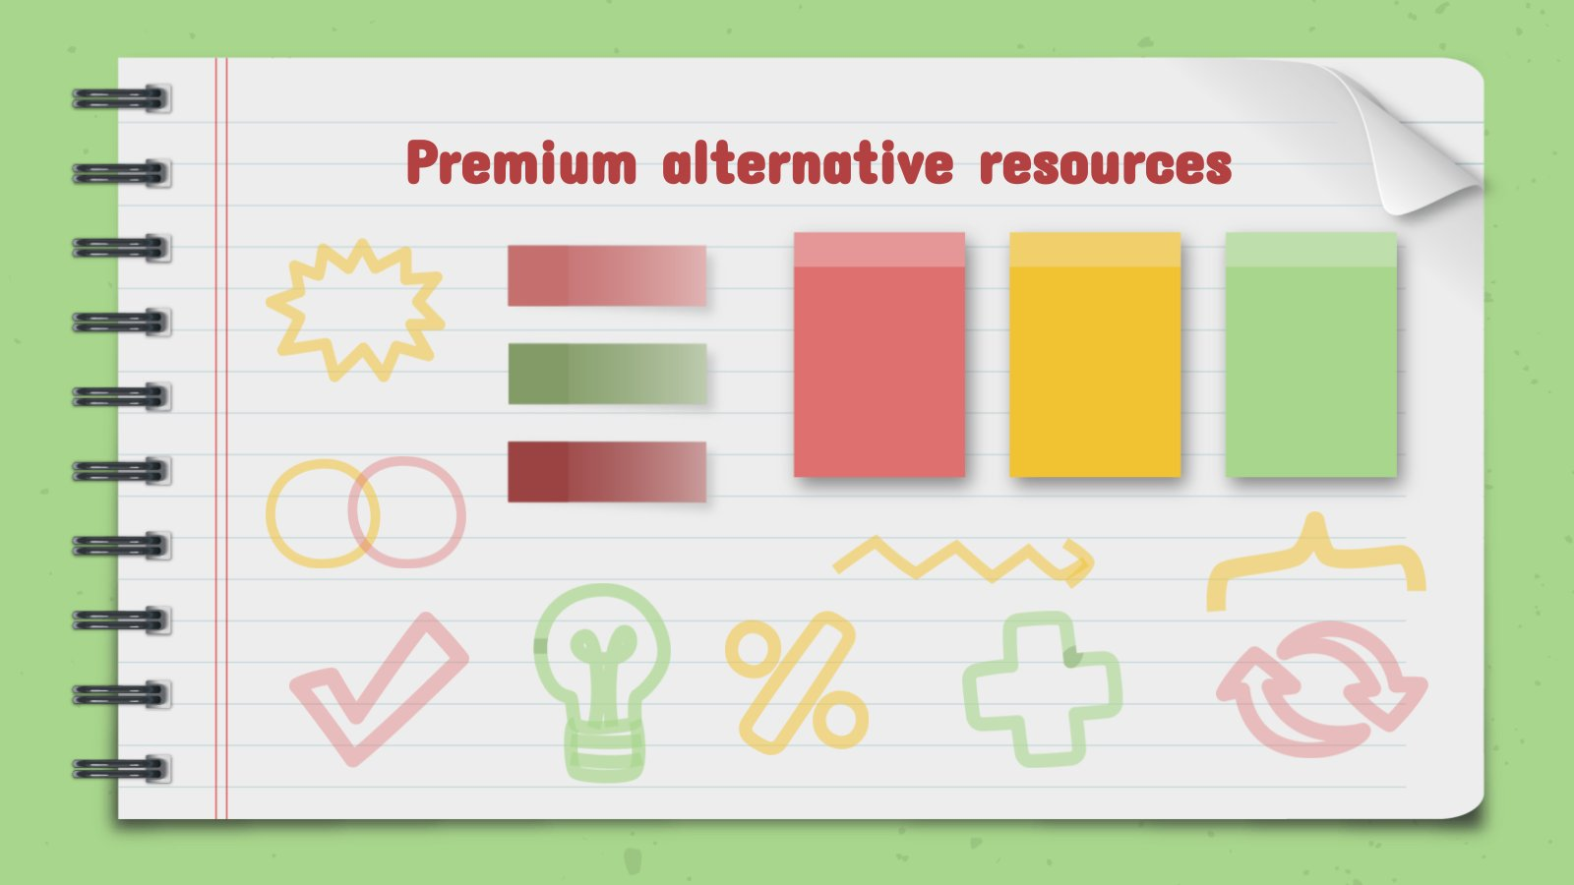
This slide is only for Premium users

Slide 69
Resources
Did you like the resources on this template? Get them for free at our other websites
PHOTOS:
Content youngster enjoying time
Teenage student sitting at table with notebook and writing
Side view woman working on laptop
Female teenager reading book in cafe near friends
Happy teen girl at lesson
Girl on armchair reading
Crop student writing in notepad

Slide 70
Resources
VECTORS:
Wooden background with checklist and pen
Open notebook with accessories
Notebook page vector
Collection of leaves and colored notes
Tablet background with hand-drawn learning items
Schedule with nice notes
ets of paper with sticky tape
Assortment of arrows highlighter
Pack of small sticky notes in realistic style

Slide 71
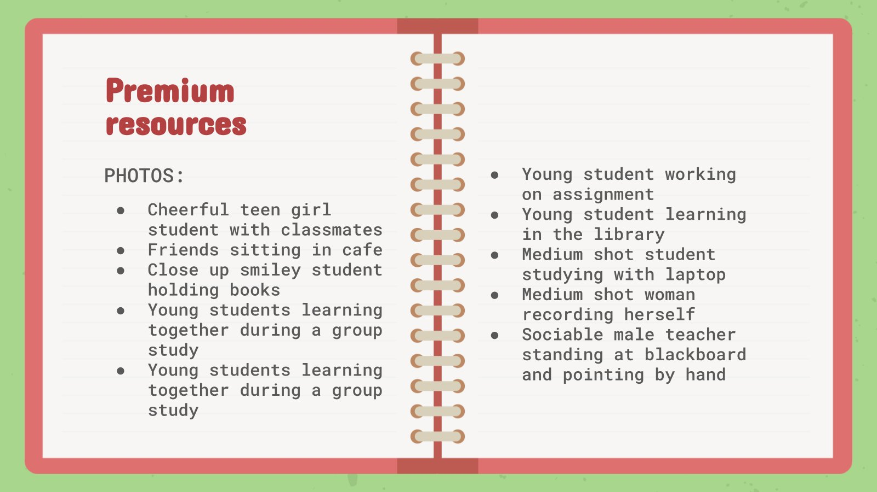
This slide is only for Premium users

Slide 72
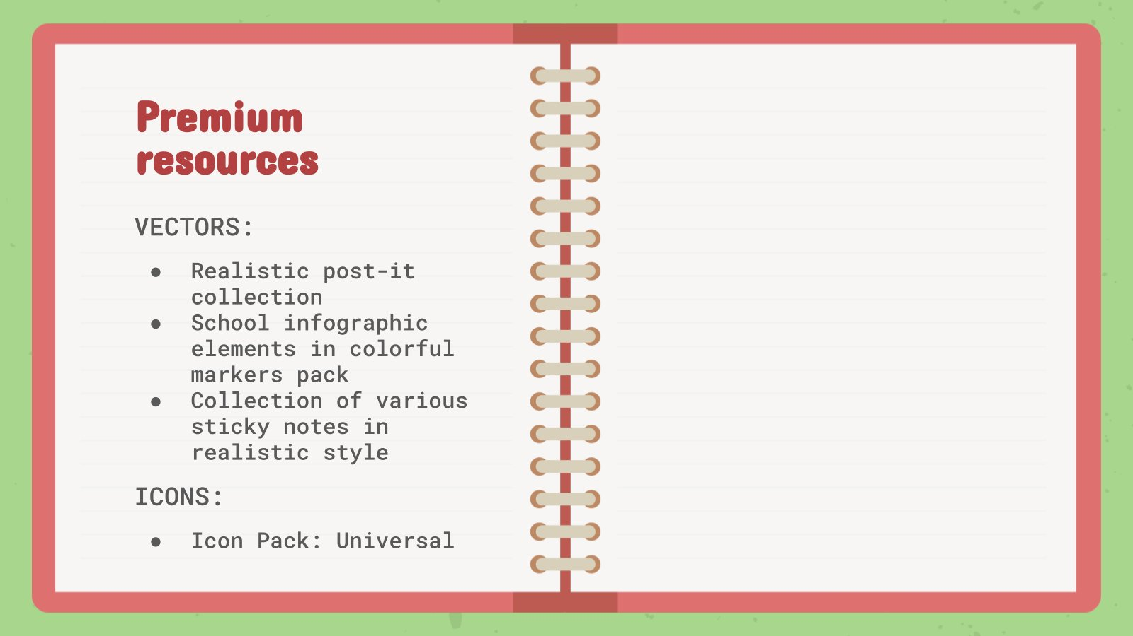
This slide is only for Premium users

Slide 73
Instructions for use
In order to use this template, you must credit Slidesgo by keeping the Thanks slide.
You are allowed to:
- Modify this template.
- Use it for both personal and commercial projects.
You are not allowed to:
- Sublicense, sell or rent any of Slidesgo Content (or a modified version of Slidesgo Content).
- Distribute Slidesgo Content unless it has been expressly authorized by Slidesgo.
- Include Slidesgo Content in an online or offline database or file.
- Offer Slidesgo templates (or modified versions of Slidesgo templates) for download.
- Acquire the copyright of Slidesgo Content.
For more information about editing slides, please read our FAQs or visit Slidesgo School:
https://slidesgo.com/faqs and https://slidesgo.com/slidesgo-school

Slide 74
Instructions for use (premium users)
As a Premium user, you can use this template without attributing Slidesgo or keeping the "Thanks" slide.
You are allowed to:
Modify this template.
Use it for both personal and commercial purposes.
Hide or delete the “Thanks” slide and the mention to Slidesgo in the credits.
Share this template in an editable format with people who are not part of your team.
You are not allowed to:
Sublicense, sell or rent this Slidesgo Template (or a modified version of this Slidesgo Template).
Distribute this Slidesgo Template (or a modified version of this Slidesgo Template) or include it in a database or in any other product or service that offers downloadable images, icons or presentations that may be subject to distribution or resale.
Use any of the elements that are part of this Slidesgo Template in an isolated and separated way from this Template.
Register any of the elements that are part of this template as a trademark or logo, or register it as a work in an intellectual property registry or similar.
For more information about editing slides, please read our FAQs or visit Slidesgo School:
https://slidesgo.com/faqs and https://slidesgo.com/slidesgo-school

Slide 75
Fonts & colors used
This presentation has been made using the following fonts:
Concert One
(https://fonts.google.com/specimen/Concert+One)
Roboto Mono
(https://fonts.google.com/specimen/Roboto+Mono)
#a8d68c
#f1c232
#b44141
#df7070
#7a9e64
#595959

Slide 76

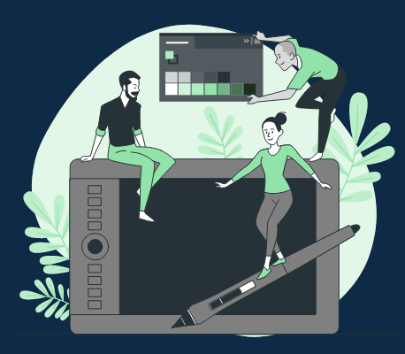



Storyset
Create your Story with our illustrated concepts. Choose the style you like the most, edit its colors, pick the background and layers you want to show and bring them to life with the animator panel! It will boost your presentation. Check out How it works.
Pana
Amico
Bro
Rafiki
Cuate

Slide 77
Use our editable graphic resources...
You can easily resize these resources without losing quality. To change the color, just ungroup the resource and click on the object you want to change. Then, click on the paint bucket and select the color you want. Group the resource again when you’re done. You can also look for more infographics on Slidesgo.

Slide 80
JANUARY
FEBRUARY
MARCH
APRIL
MAY
JUNE
PHASE 1
Task 1
Task 2
PHASE 2
Task 1
Task 2
JANUARY
FEBRUARY
MARCH
APRIL
PHASE 1
Task 1
Task 2

Slide 83
...and our sets of editable icons
You can resize these icons without losing quality.
You can change the stroke and fill color; just select the icon and click on the paint bucket/pen.
In Google Slides, you can also use Flaticon’s extension, allowing you to customize and add even more icons.

Slide 84
Educational Icons
Medical Icons

Slide 85
Business Icons
Teamwork Icons

Slide 86
Help & Support Icons
Avatar Icons

Slide 87
Creative Process Icons
Performing Arts Icons

Slide 88
Nature Icons

Slide 89
SEO & Marketing Icons

Slide 90


